Slide 1
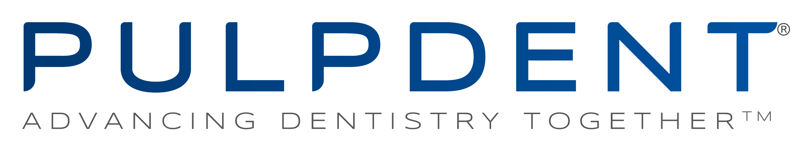
Notes:
“SAVE THAT TOOTH”
MI Dentistry
Innovation through science and technological breakthrough

Slide 2
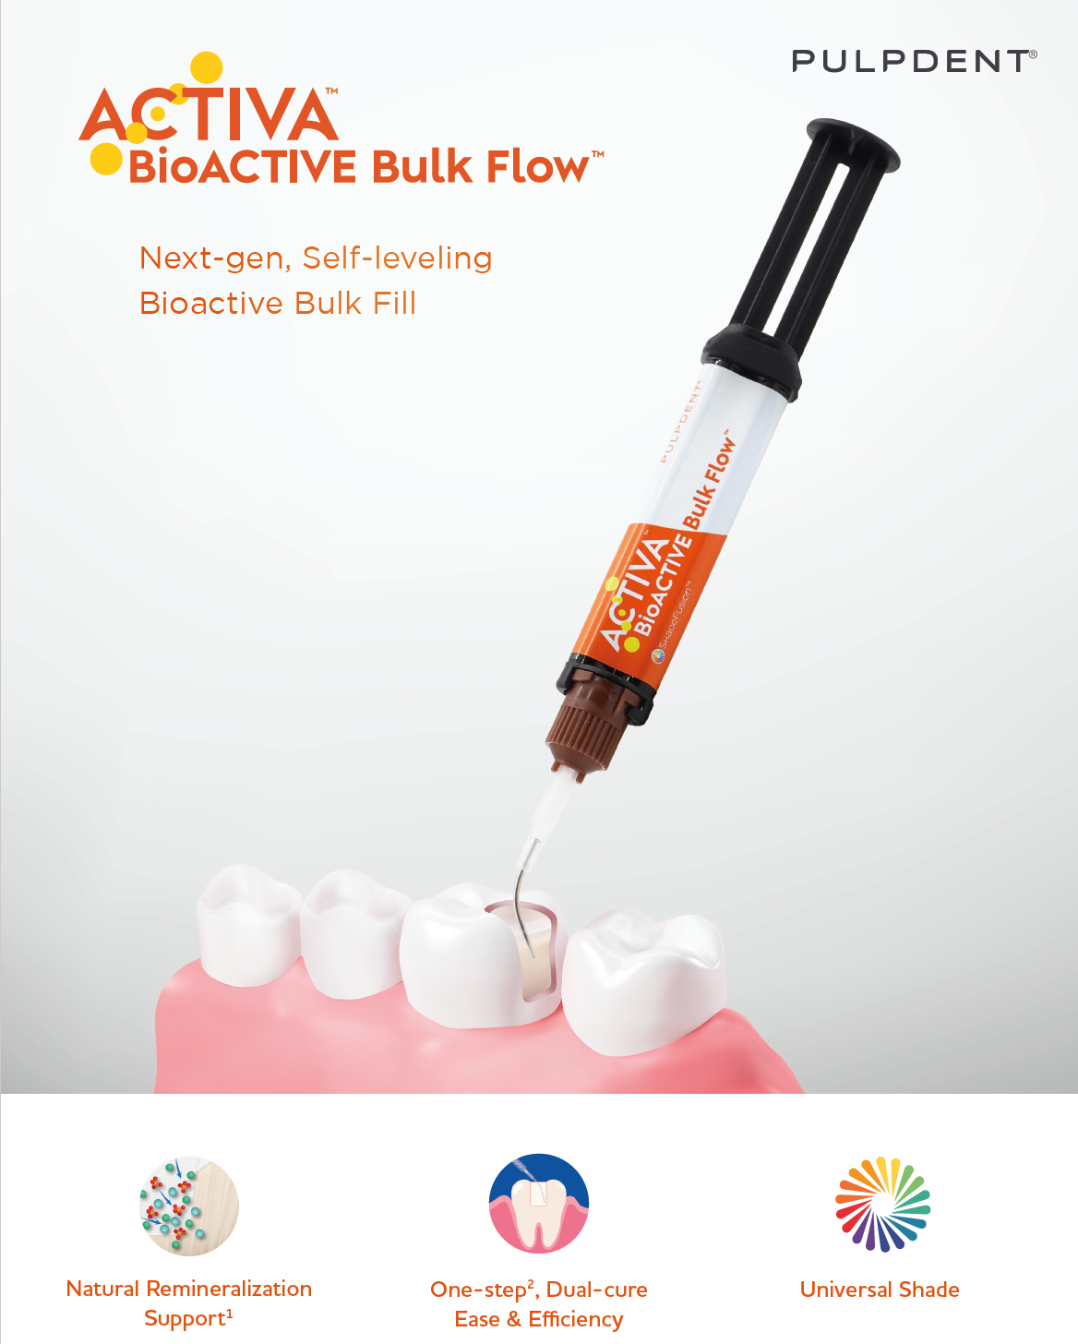
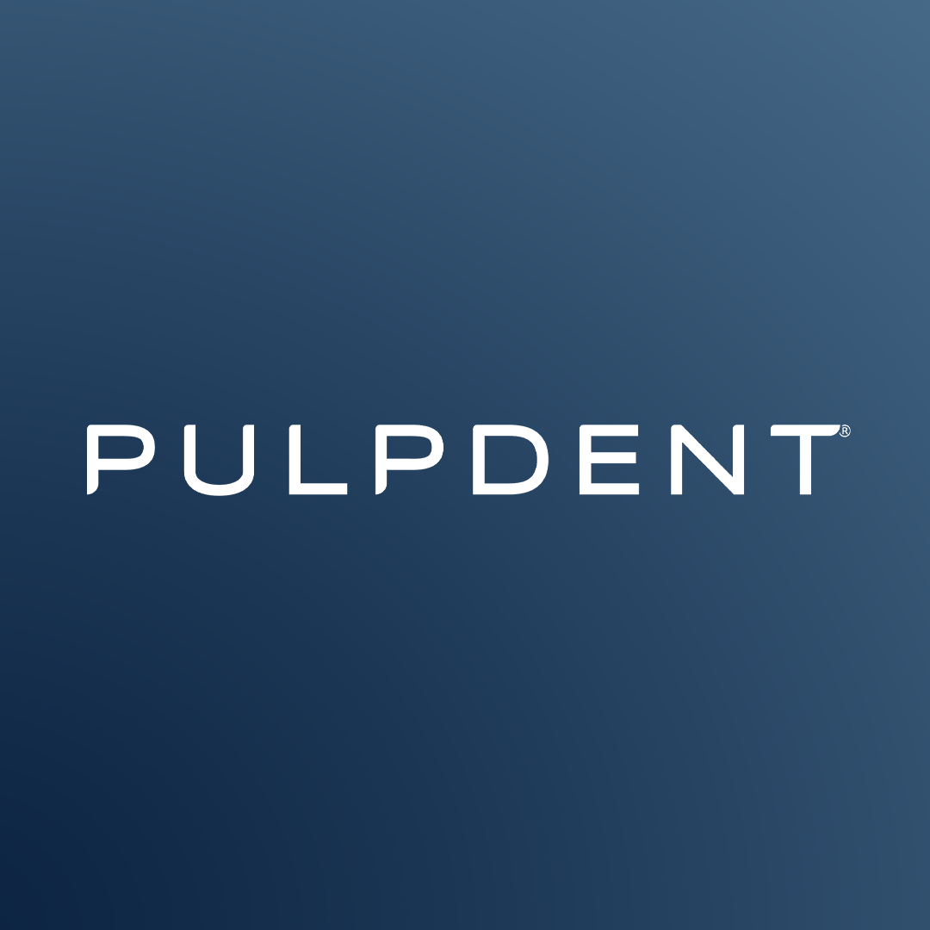


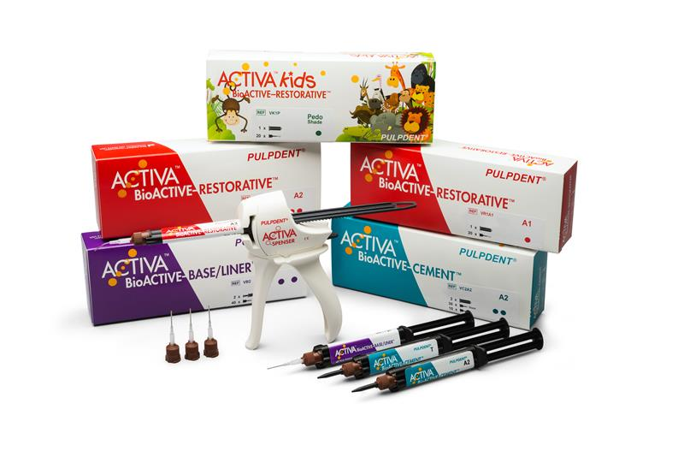
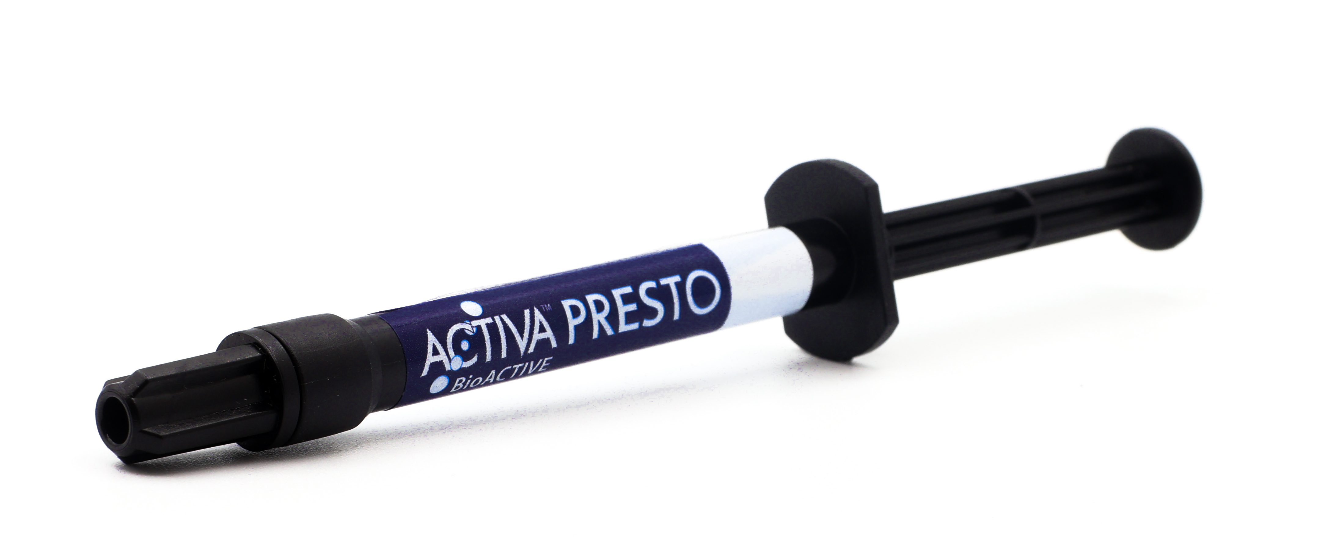

Natural Remineralization* Support
Protection* against Secondary Caries
PATIENT TREATMENT SYSTEM
* See last slide for definitions and citations
Notes:
Product Dev: Primarily:
New Users:
Low Visc/Self Leveling Segment -> Product System expansion to capture a different handling preference and flow preference
Bulk Fill Specific Targeting, primary and secondary targets - marketing segmentation
Re-engage Lost Users:
1) Gun, radiopacity, wear resistance

Slide 3
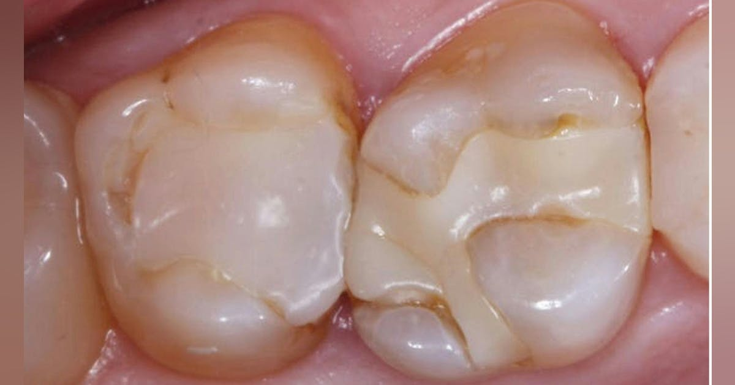
Have you seen this before?
Notes:
Cause is degradation of the restoration adhesive hybrid interface due to:
Destabilized Collagen & polymer breakdown by hydrolysis, MMPs, bacterial incursion
Collagen cross linking
MMP inhibition
Over 50-60% of restorations today are replacements or repairs
Cause of failure is #1, secondary caries, #2 fracture
Long term adaptation and marginal integrity is the key to long lasting restorations

Slide 4
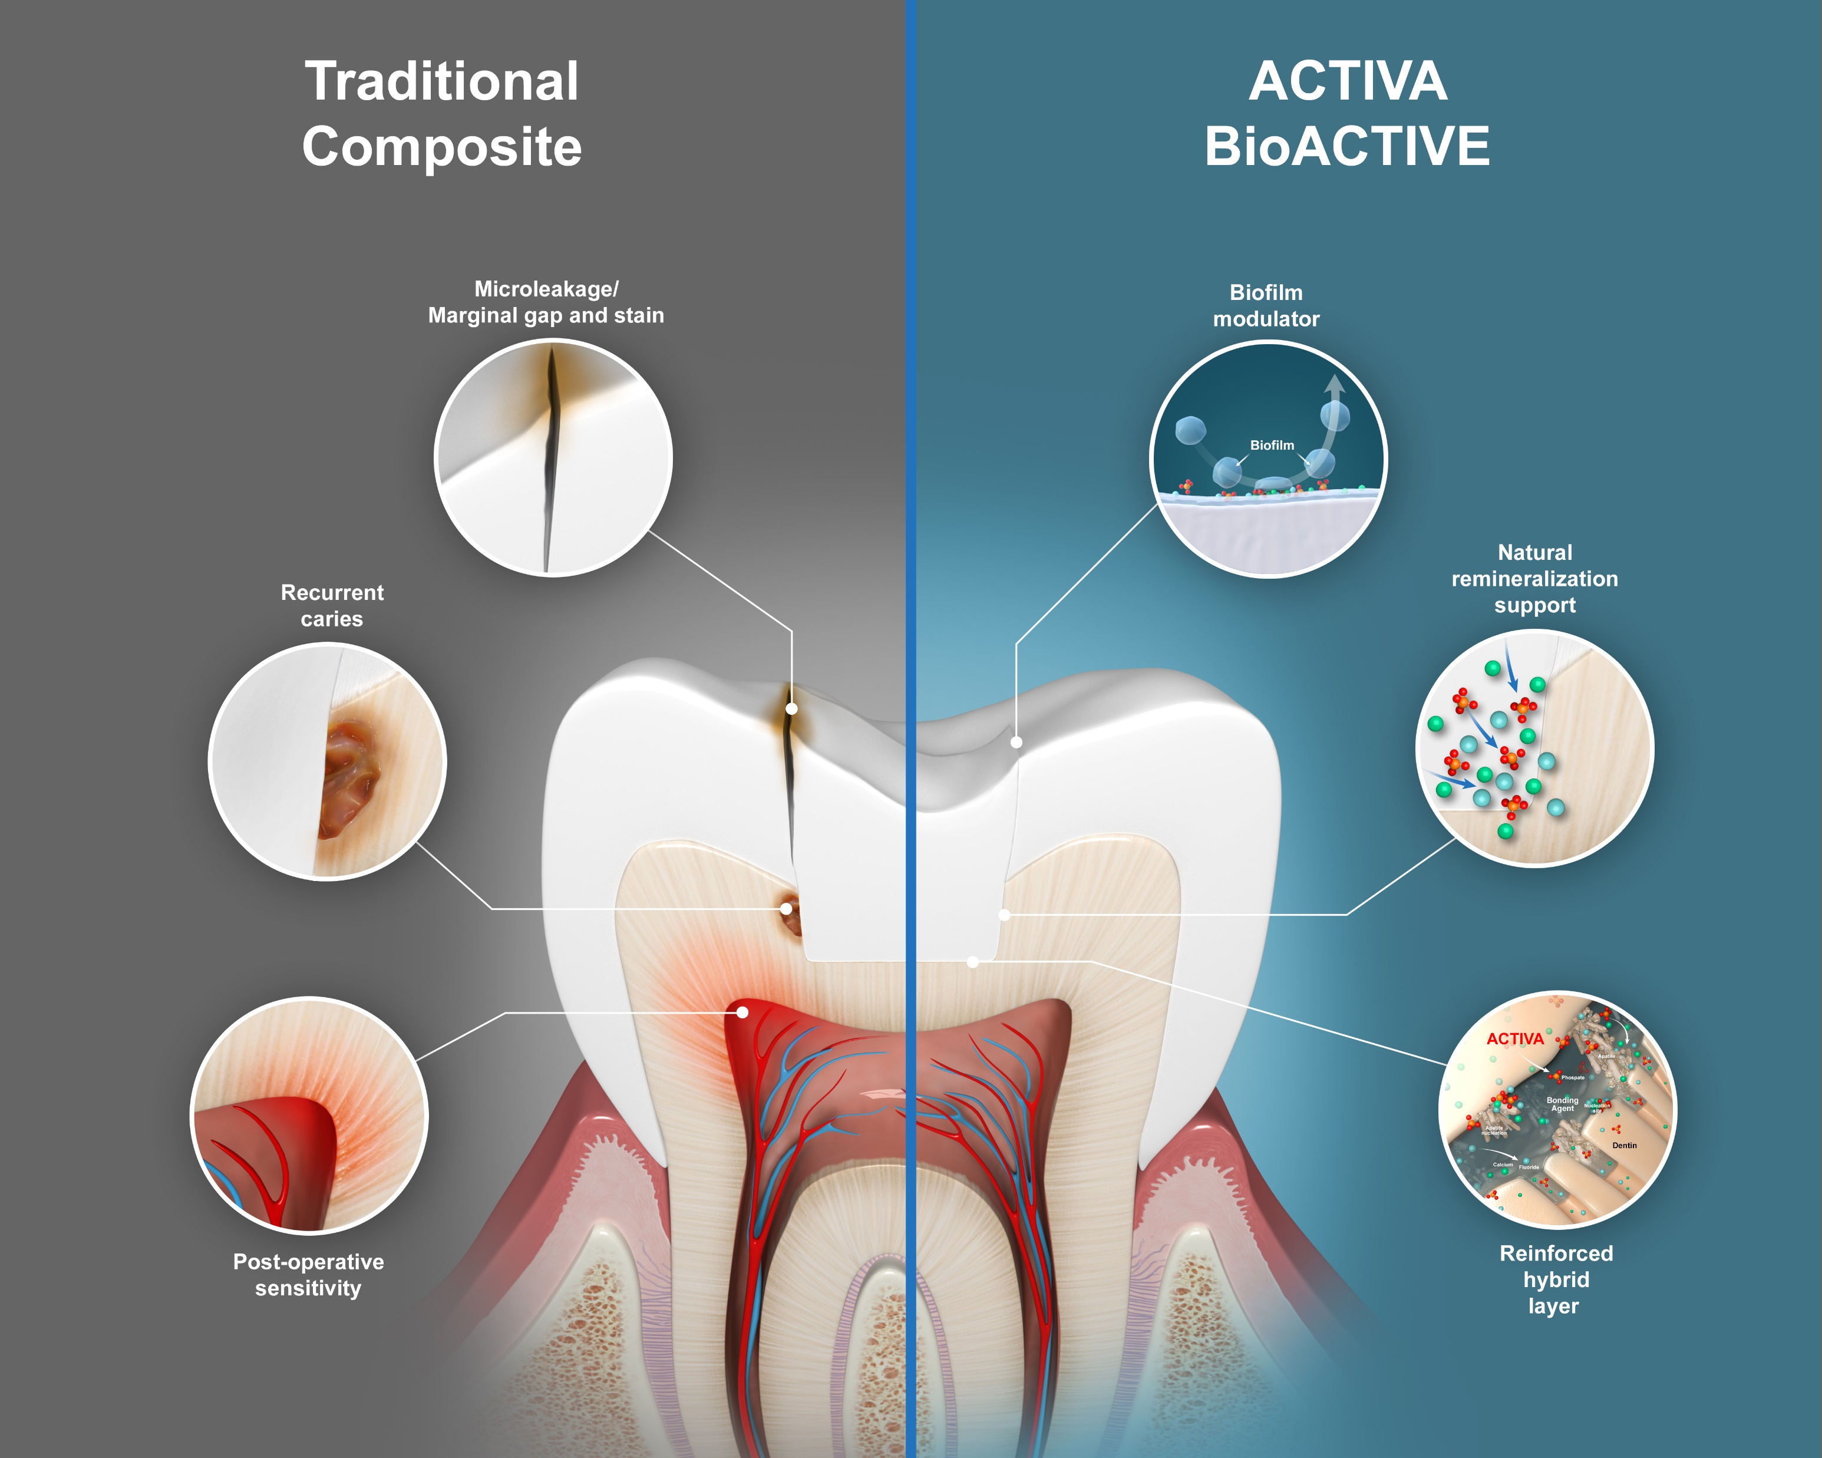
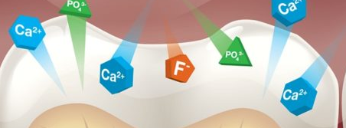
ACTIVA’s BIOACTIVITY HELPS SOLVE CURRENT PROBLEMS
IN ADHESIVE DENTISTRY
THE PROBLEM SEEN DAILY
THE SOLUTION IS BIOACTIVE
Proprietary ION-X™ Polymer Technology
REMINERALIZATION
Support
BIOFILM
Modulation
Bioactive Problem Solving
Notes:
Extend service life of restoration, substantially delaying the death spiral for the benefit of patient health

Slide 5
2025 NEW PRODUCT LAUNCH

Slide 6

Natural Remineralization* Support
Protection* against Secondary Caries
* See last slide for definitions and citations
Notes:
Product Dev: Primarily:
New Users:
Low Visc/Self Leveling Segment -> Product System expansion to capture a different handling preference and flow preference
Bulk Fill Specific Targeting, primary and secondary targets - marketing segmentation
Re-engage Lost Users:
1) Gun, radiopacity, wear resistance

Slide 7

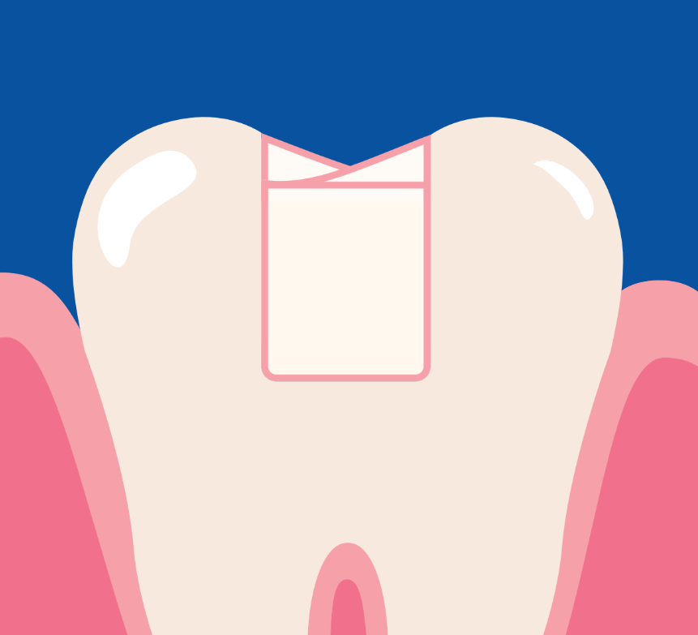
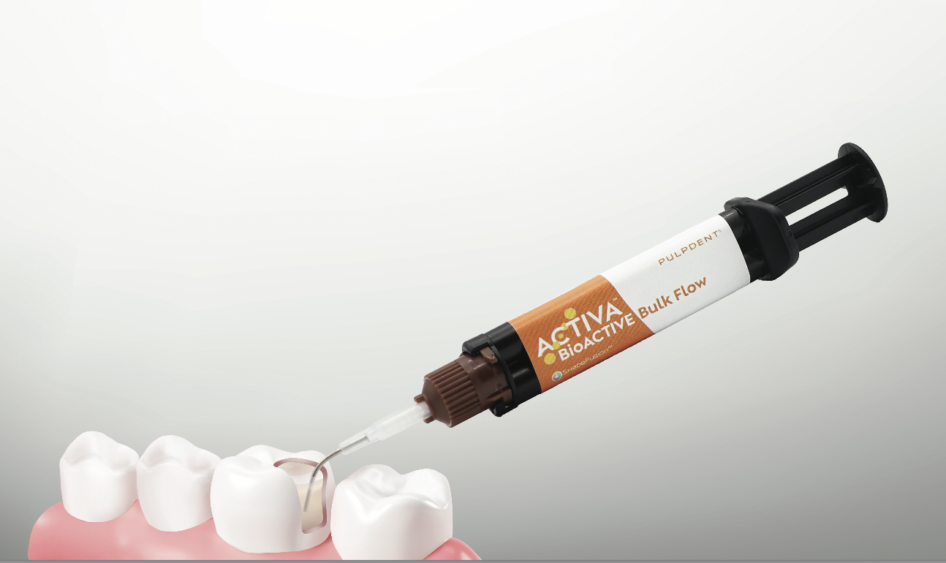



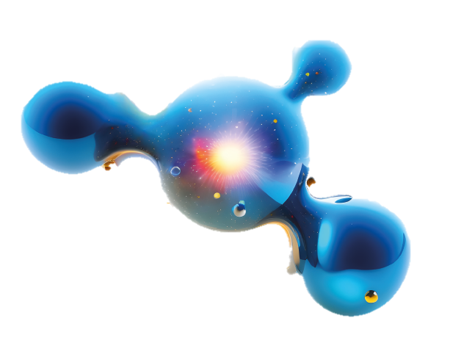
Caries Management
Natural Remineralization* Support
Protection* against Secondary Caries
Bulk Fill Restorative
Self-Leveling
THE ULTIMATE CLASS II (& I) SOLUTION
BUILT ON AWARD WINNING ACTIVA BIOACTIVE
BULK FILL
Efficiency & Ease
Self-Leveling Flowable Composite
Dual Cure
Patented Anti-Stress Elastomer
UNIVERSAL SHADE
Color Matching Simplicity
Chroma matching technology
REMINERALIZATION Support
& Protection*
Proprietary ionic polymer matrix
Product Overview
Notes:
Product line extension of ACTIVA Bioactive Patient Treatment System

Slide 8
BULKFILL YOUR WAY

Slide 9
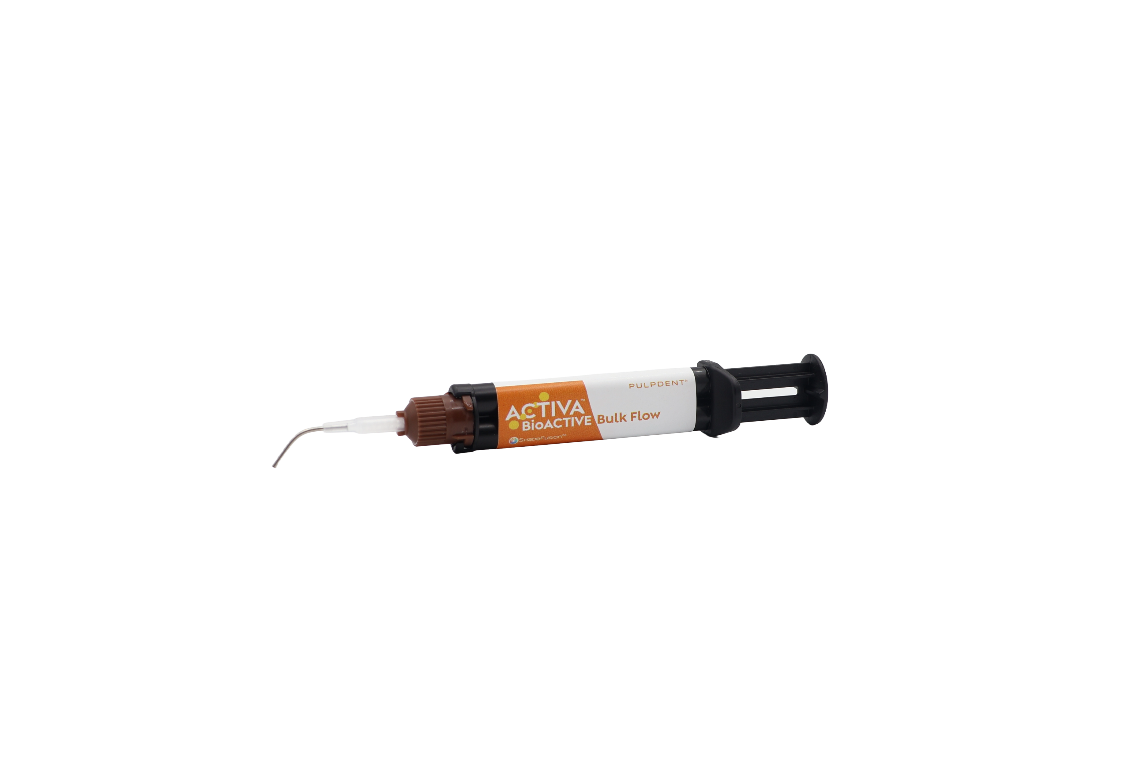
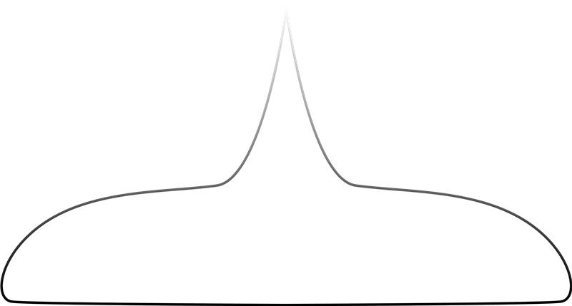
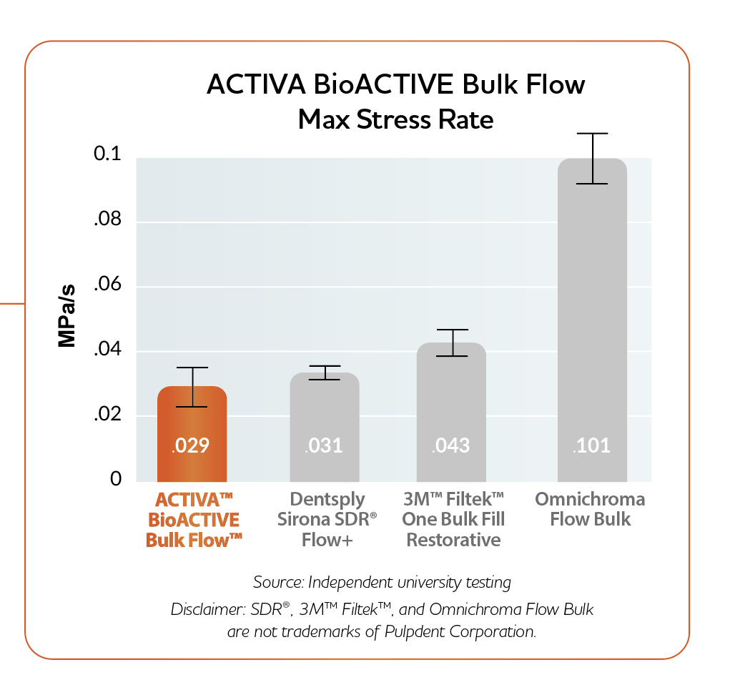
Natural Remineralization Support
Protection against Secondary Caries
REDUCE Chair TIME + TECHNIQUE SENSITIVITY
Patented anti-stress elastomer (MODULUS™) delivers lowest
Polymerization Stress Rate*
BULK FLOW YOUR WAY
Dentin Replacement + Layered Composite
Self-Leveling Flow for high adaptation with less manipulation
Unlimited Depth of Cure (Dual Cure) Bulk Fill
With or Without Capping*
Dentin + Enamel Replacement in 1-Step Placement
Bulk Fill Efficiency & Ease
Notes:
*Capping is recommended by clinician’s judgement under heavy occlusal load or

Slide 10
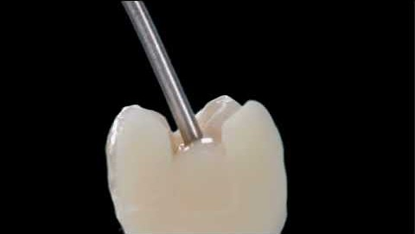
Self Leveling FLOW
Notes:
Lovely adaptation in the proximal box.

Slide 11
Simplicity and ease of UNIVERSAL

Slide 12
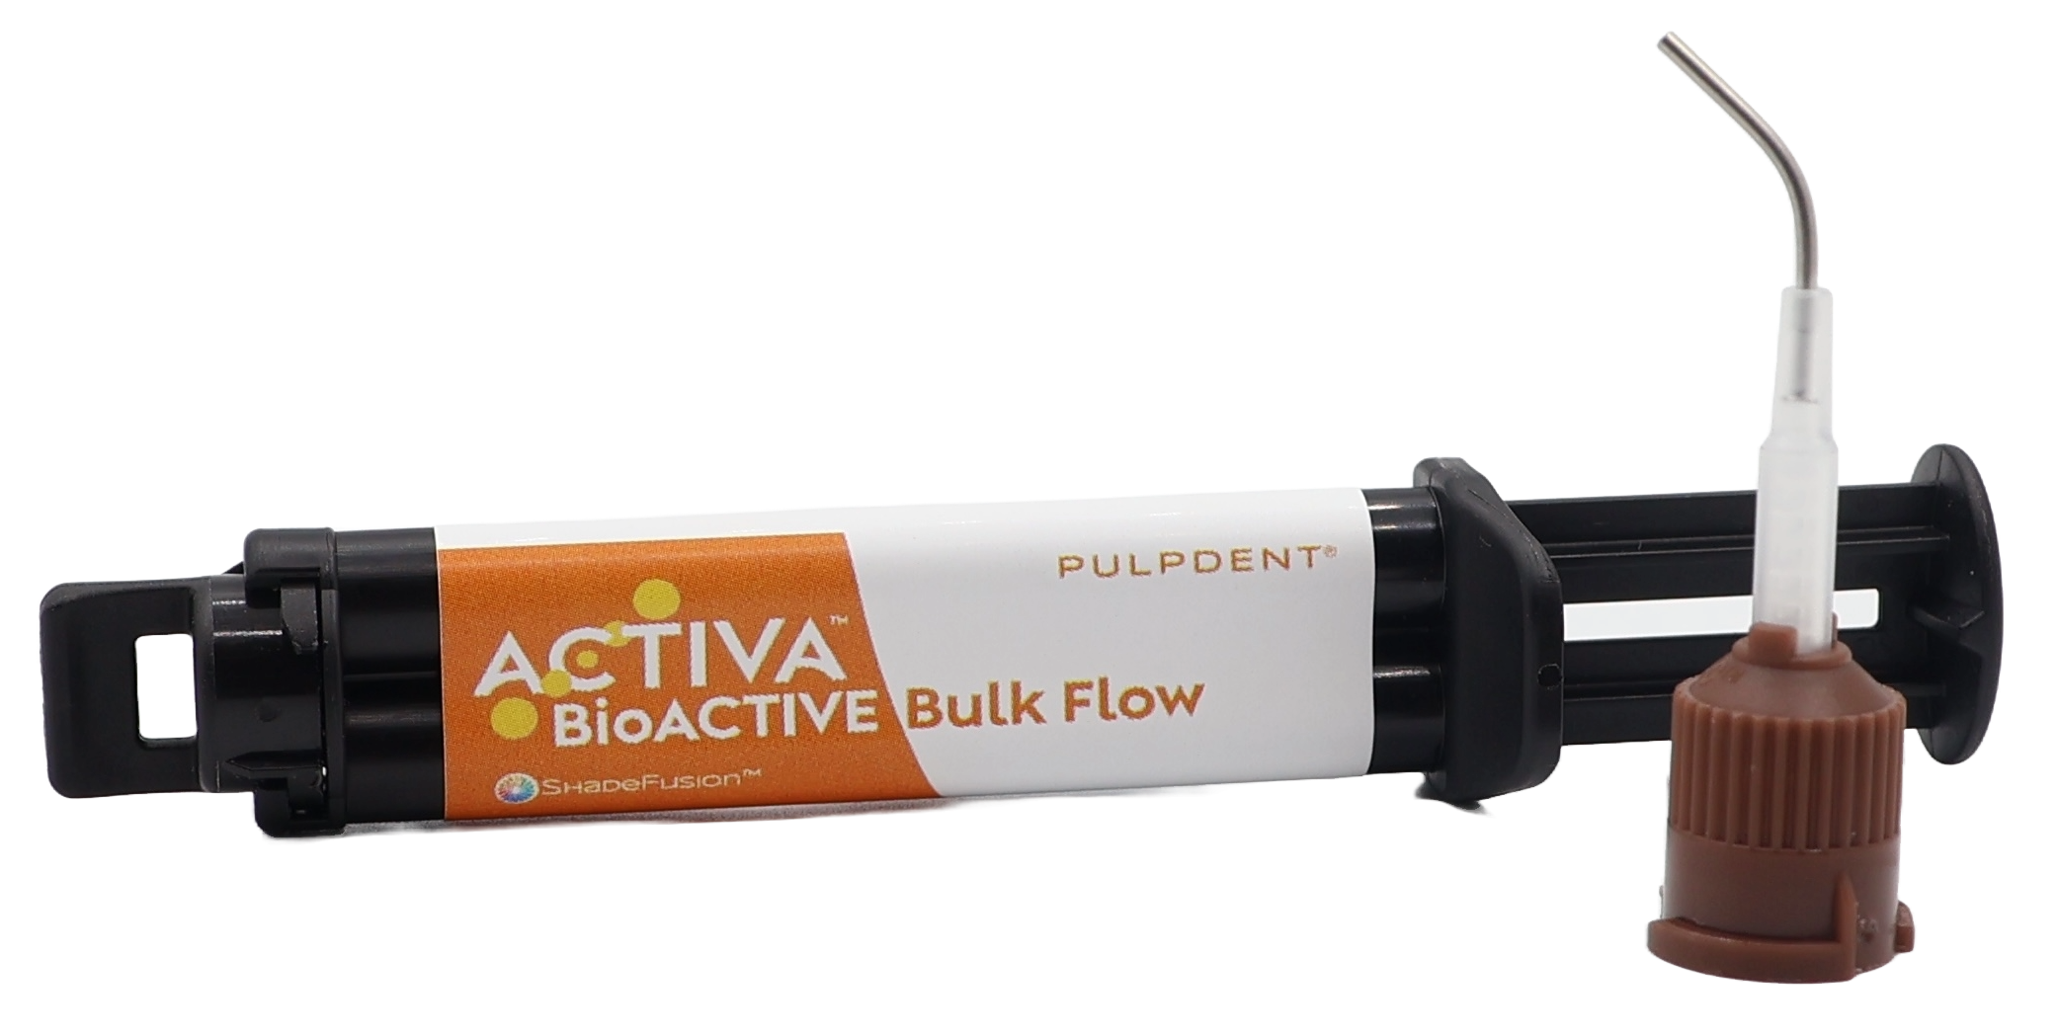
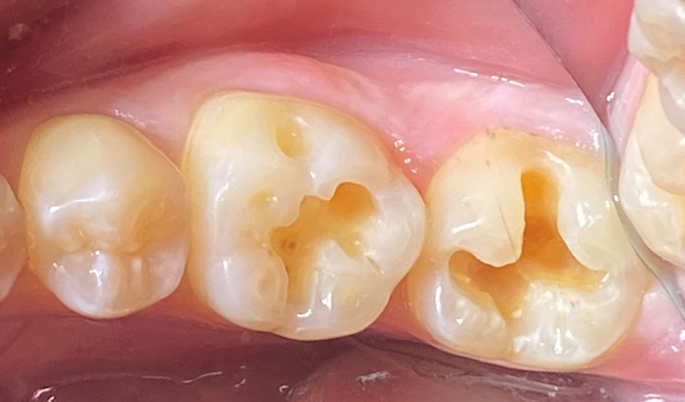
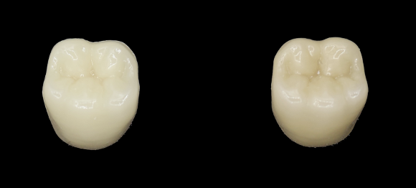
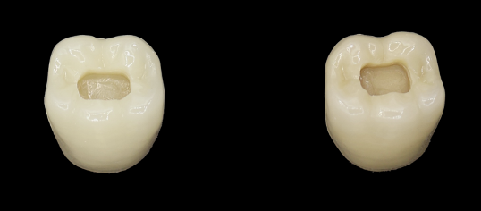
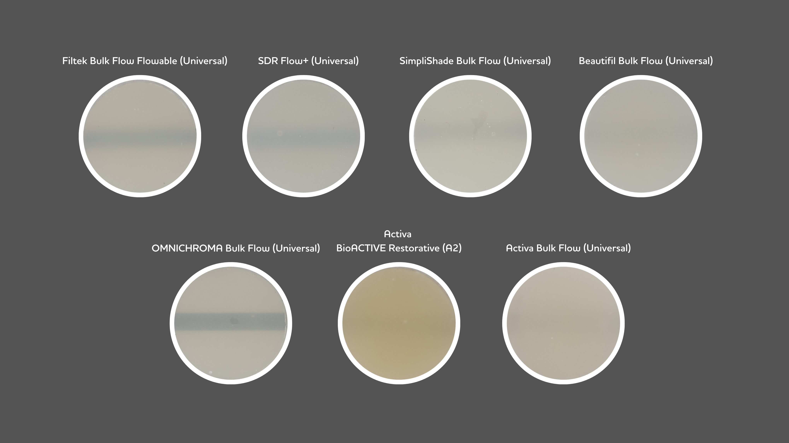
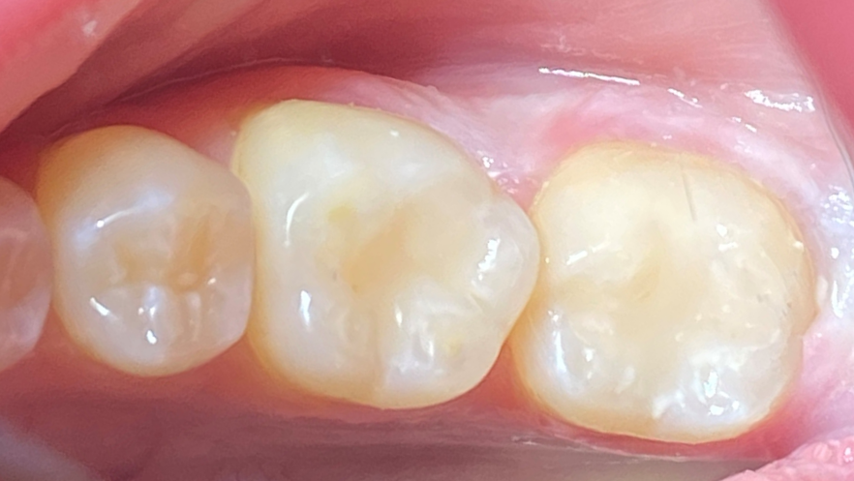
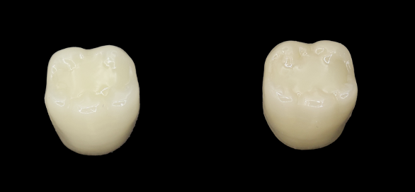
Natural Remineralization Support
Protection against Secondary Caries
COLOR MATCHING SIMPLICITY OF UNIVERSAL
Case courtesy Dr. Neville Hatfield
A2
A4
Before
Shade Matching Technology
that works differently
Class I Prep
Competitor Bulk Flow (Universal Shade)
Filled
ShadeFusion™ Technology
Notes:
Originally in FlowsRite flowable composite over a decade ago.
Excellent blend between wide range of shades, A1-a4 on vita denture teeth (Plus C & D shades in between)
Other products may require blocker – ideal opacity and translucency reduces the need for a blocker or opaquer in most cases. Will not show greyness like competitors in class II.
Shadefusion works differently:
Our technology works not just through translucency and specular reflection of underlying color, but also biomimetically, borrowing concepts from camouflaging animals like chameleons and cephalopods - through diffuse chameleon or chromatophoric effect like an octopus or chameleon (photonic crystals).
Less specular reflection, more diffuse reflection – creates more optical scattering
Like a chromatophere, some chroma (pigment) is present in ACTIVA, waveforms of light constantly undergo refraction and diffraction within the material
Ultimately the human eye perceives a smooth blended transition between tooth and restoration, enabling true visual harmony of the restoration.
Save on inventory complexity
Time on color matching

Slide 13
Bioactive remineralization support
& BIOFILM MODULATION

Slide 14
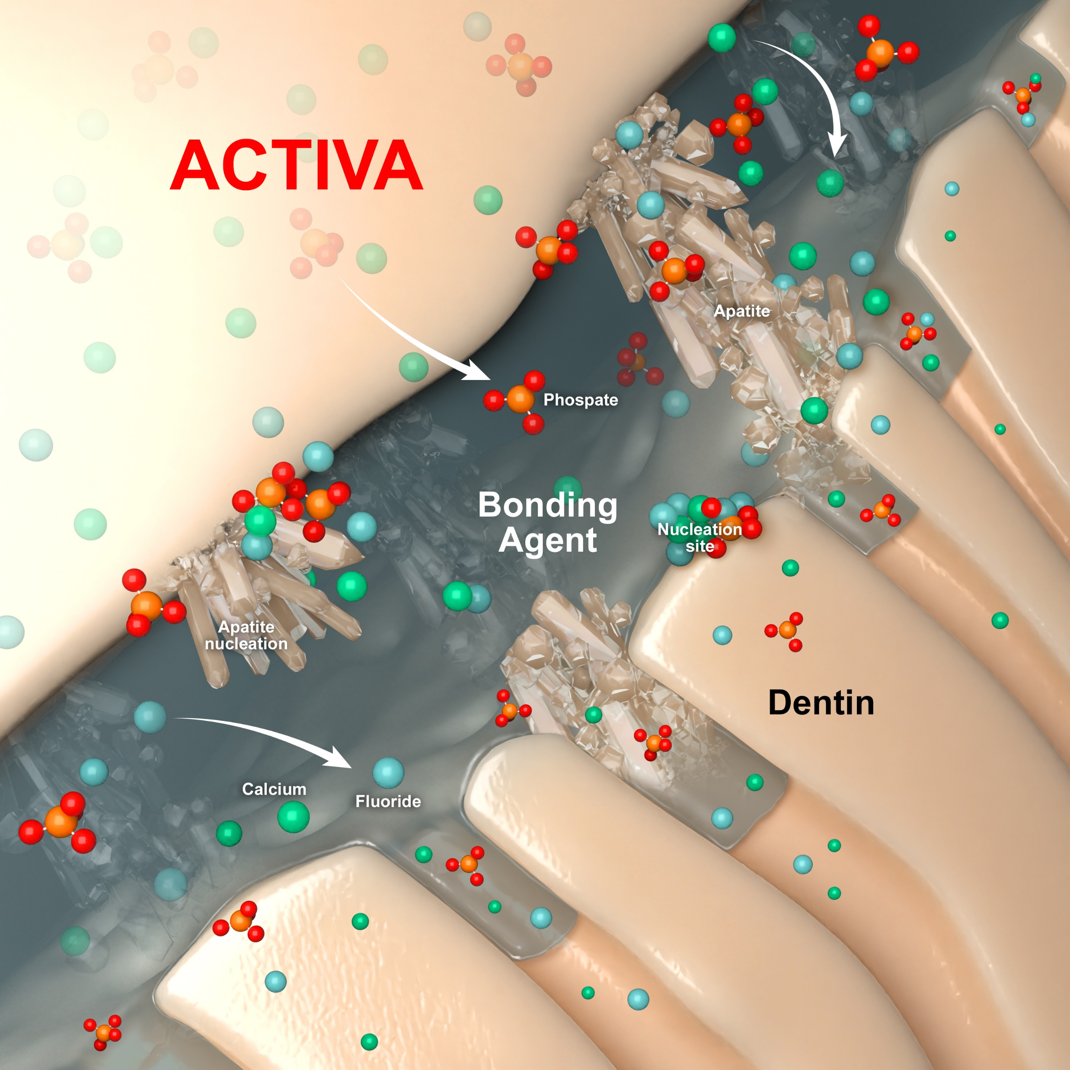
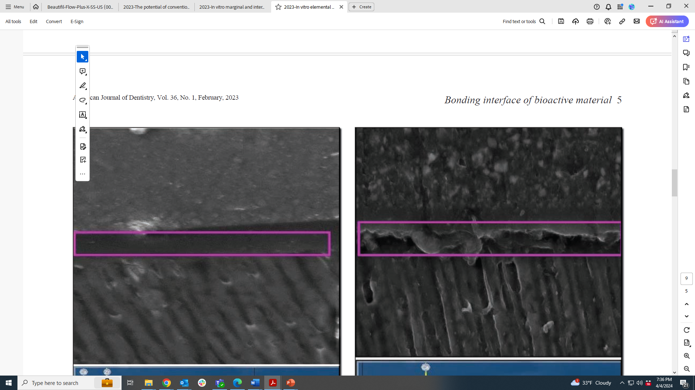
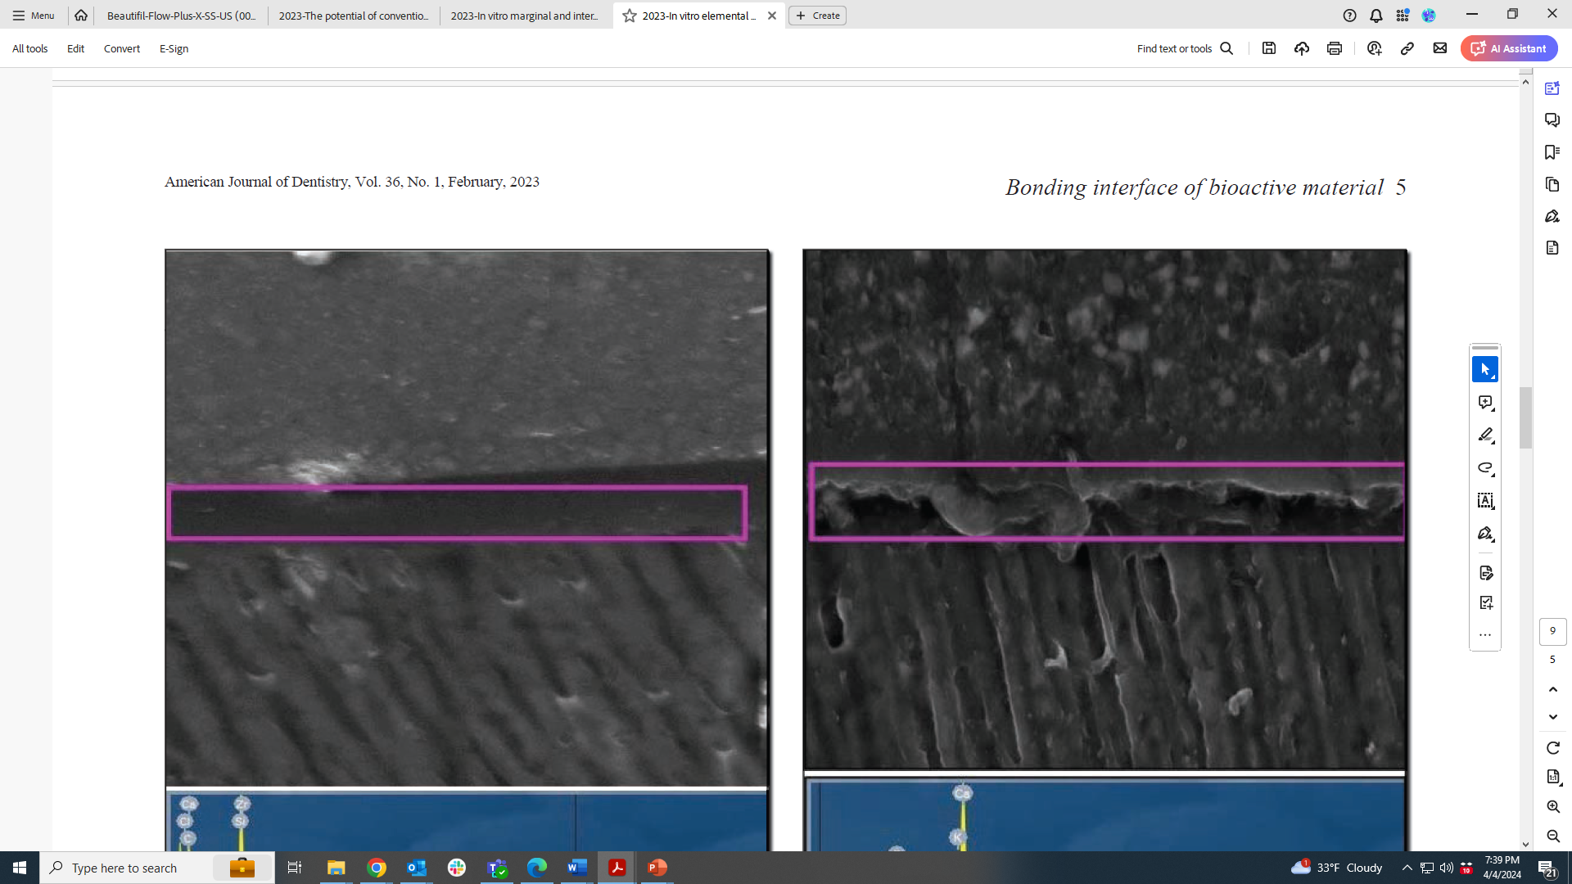
Natural Remineralization Support
Protection against Secondary Caries
ACTIVA’S REMINERALIZATION SUPPORT SEALS AGAINST MICROLEAKAGE AND INCREASES MINERAL DENSITY OF SURROUNDING TISSUE
1. Mechanism
2. Effects
MINERAL APATITE FORMATION
Hardens surrounding tissue
Stabilize + Reinforces Adhesive Hybrid Layer
2.
ACTIVA bonding interface
3M Bulk Fill bonding interface
Scanning electron micrographs of the ACTIVA BioACTIVE Restorative groups showed a thicker acid-base resistant hybrid-like layer with a distinct crystallization pattern (Raghip et al, 2023)
Remineralization Support & Patient Protection
Notes:
Raghip, A. G., Comisi, J. C., Hamama, H. H., & Mahmoud, S. H. (2023). In vitro elemental and micromorphological analysis of the resin-dentin interface of bioactive and bulk-fill composites. American Journal of Dentistry, 36(1), 3-7.
Adhesive/Hybrid layers naturally degrade from hydrolysis, bacterial byproducts and MMPs.
Bioactive mineral apatite formation and ion release stabilizes the adhesive layer over time, creating a longer lasting protective treatment for the tooth and restoration
Conventional composite shows no benefit
Biomimetic, nucleation events not release or precipitation.
pH Reactive
More conservative patient treatments
Supports selective caries removal (SCR) technique
Works with all adhesive systems

Slide 15
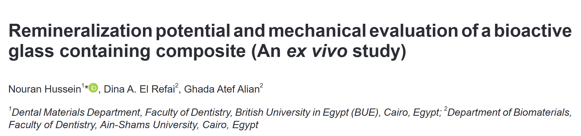
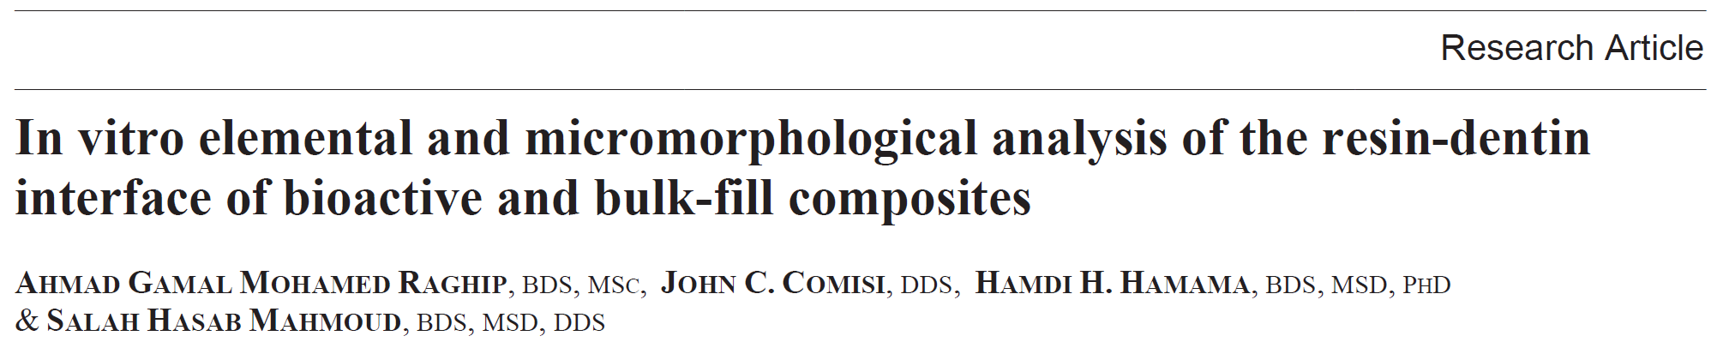
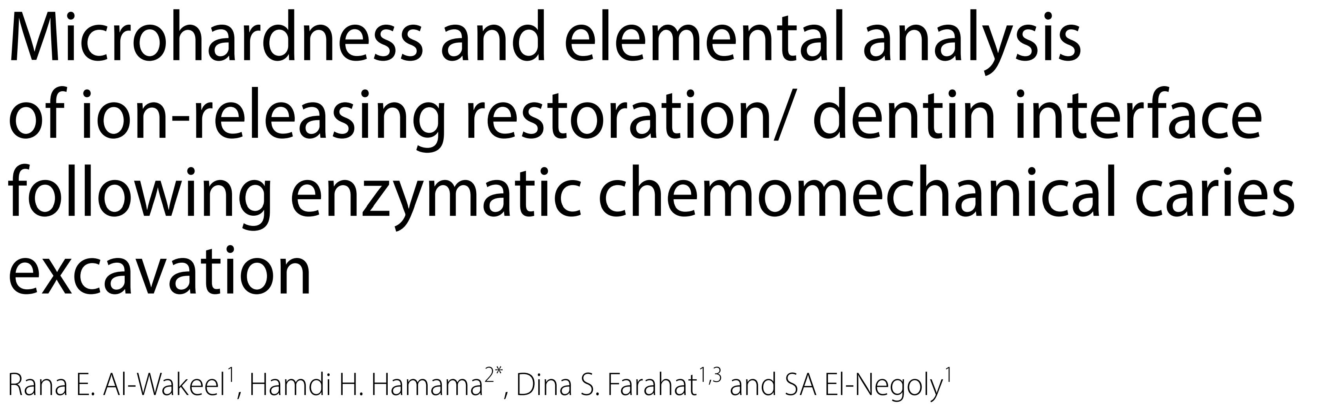
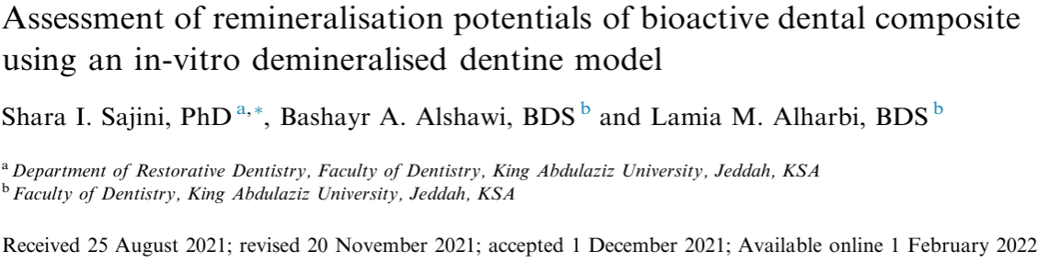

Natural Remineralization Support
Protection against Secondary Caries
ACTIVA’S REMINERALIZATION SUPPORT IS EXTENSIVELY STUDIED & CLINICALLY PROVEN
Remineralization Support & Patient Protection

Slide 16
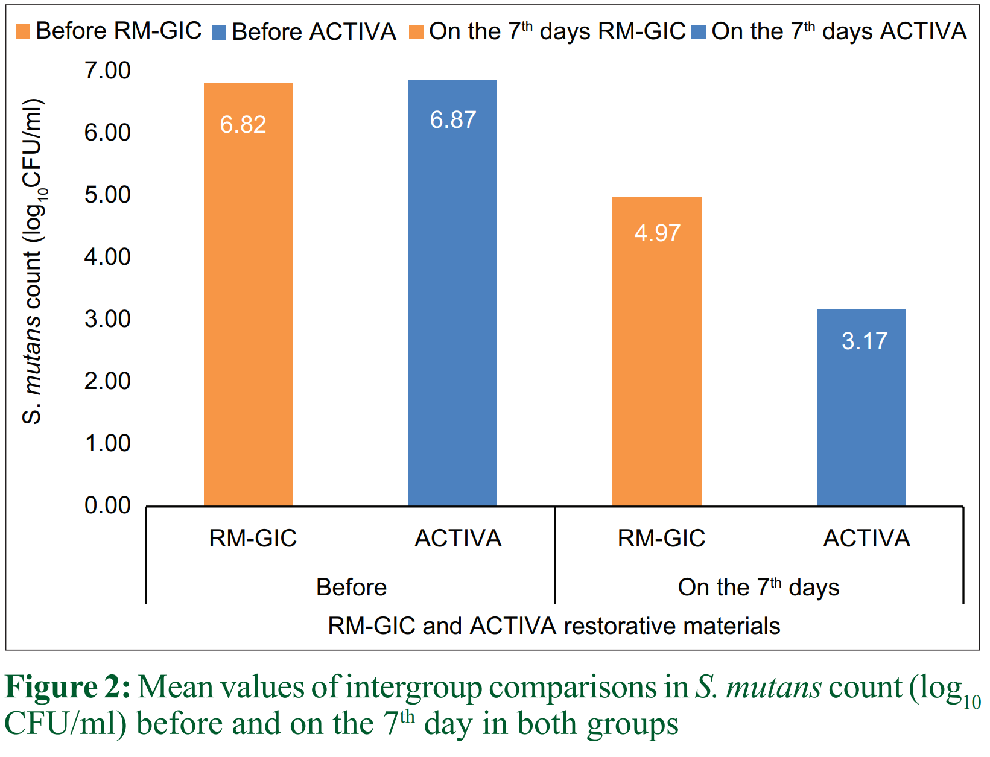
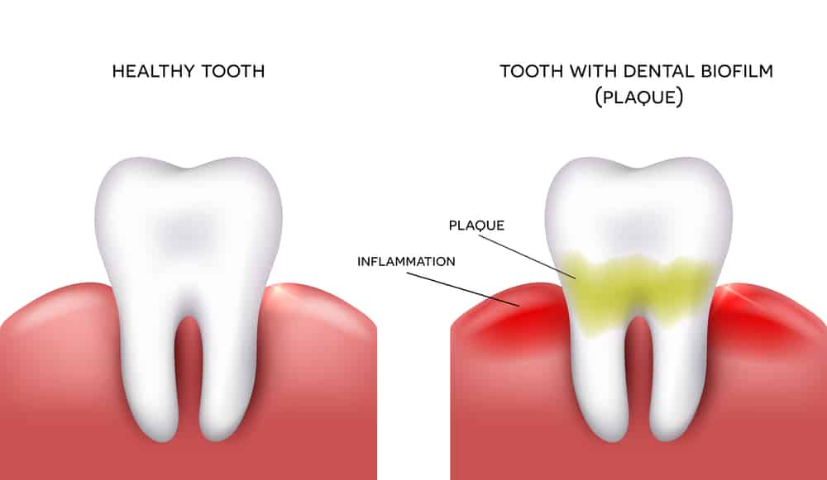
Natural Remineralization Support
Protection against Secondary Caries
BIOFILM MODULATION EFFECTS PROTECT AGAINST DEMINERALIZATION, AIDS PREVENTATIVE CARE
Lower biofilm surface adhesion on the completed ACTIVA restoration was observed, which was more easily disrupted by shear forces (J. Mah, J. Merritt, J. Ferracane, 2017)
Lower surface aggregation (S. mutans) and plaque index scores were observed, (Maher et al, 2023)
Minimizes problems caused by plaque which may lead to restorative failure
Biofilm Modulation
Notes:
Reference for the picture: Bjørndal, L.; Demant, S.; Dabelsteen, S. Depth and activity of carious lesions as indicators for the regenerative potential of dental pulp after intervention. J. Endod. 2014, 40, S76–S81
- Maher, Y. A., Rajeh, M. T., Hamooda, F. A., Zerain, G. O., Habis, R. M., Sulaimani, R. H., ... & Abdelaleem, N. A. (2023). Evaluation of the Clinical Impact and In Vitro Antibacterial Activities of Two Bioactive Restoratives against S. mutans ATCC 25175 in Class II Carious Restorations. Nigerian Journal of Clinical Practice, 26(4), 404-411.
Sajini, S. I., Alshawi, B. A., & Alharbi, L. M. (2022). Assessment of remineralisation potentials of bioactive dental composite using an in-vitro demineralised dentine model. Journal of Taibah University Medical Sciences, 17(4), 640-647.
Hussein, N., El Refai, D. A., & Alian, G. A. (2021). Remineralization potential and mechanical evaluation of a bioactive glass containing composite (An ex vivo study). Open Access Macedonian Journal of Medical Sciences, 9(D), 179-185.
-Al-Wakeel, R. E., Hamama, H. H., Farahat, D. S., & El-Negoly, S. A. (2024). Microhardness and elemental analysis of ion-releasing restoration/ dentin interface following enzymatic chemomechanical caries excavation. BMC oral health, 24(1), 581. https://doi.org/10.1186/s12903-024-04304-8

Slide 17

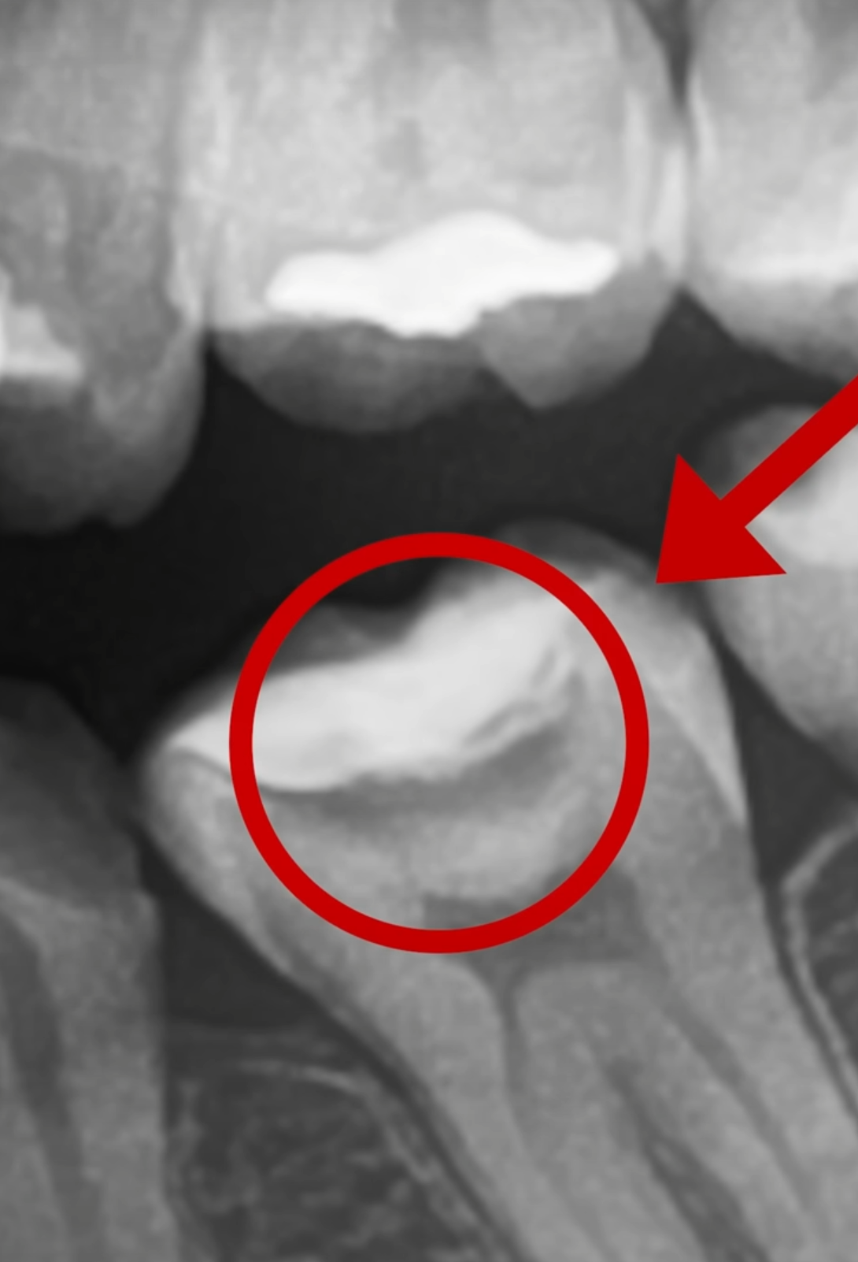


Natural Remineralization Support
Protection against Secondary Caries
THE BIOACTIVE DIFFERENCE IS PATIENT-CENTERED CARE
REMINERALIZATION SUPPORT
BIOFILM
MODULATION
3. Patient Benefits
Protects against Microleakage + Secondary Caries
Reduces incidence of Post-Operative Sensitivity
Prolongs life-span of a restoration
Patient Centered, Patient Benefits
Notes:
Release is larger at low pH, recharges at neutral pH
Hardening of dentin
Mineral Apatite formation
Surface biofilm modulation
Proprietary hydrophilic polymer matrix chemistry ( ) powers ionic fluoride, calcium and phosphate exchange + subsequent bioactive remineralization support & modulation of biofilm
Virtuous cycle

Slide 18
The competition

Slide 19
ACTIVA Bulk Flow & The Competition
Competitive Comparison
Notes:
https://www.ncbi.nlm.nih.gov/pmc/articles/PMC9356364/

Slide 20
Clinical Cases

Slide 21
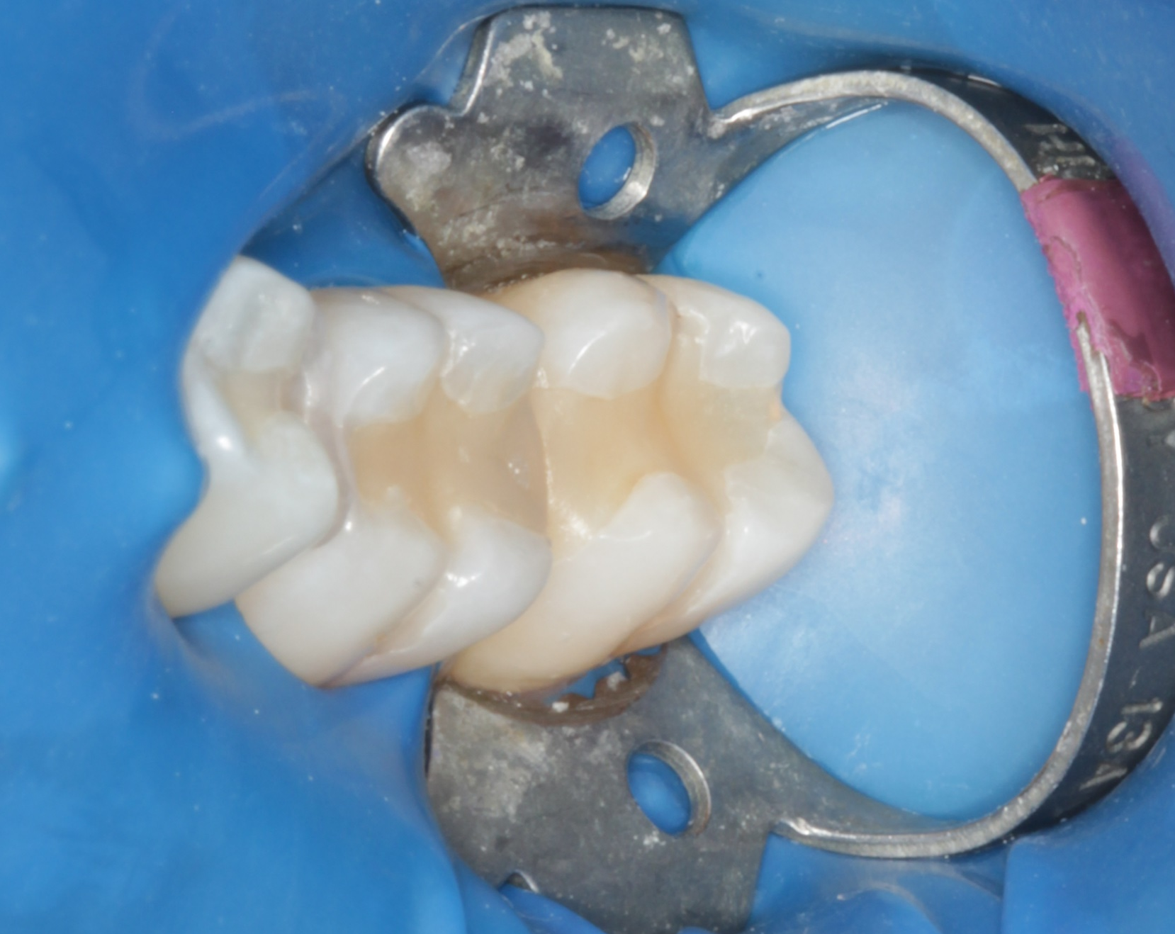
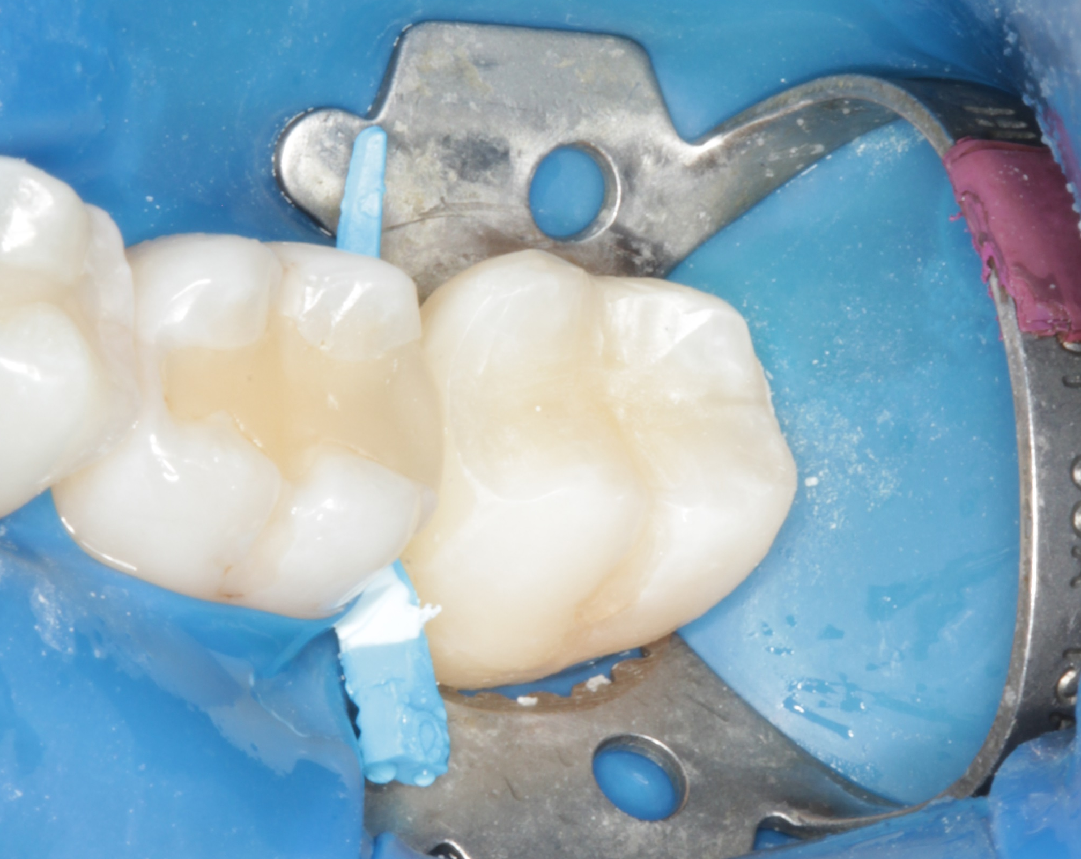
THE ACTIVA BioACTIVE PATIENT TREATMENT
Natural Remineralization* Support
Protection* against Secondary Caries
Large Class II Restoration
Before
After
Case courtesy Dr. Les Rykiss
Cases
Notes:
Tooth 18 secondary caries recurrent decay

Slide 22
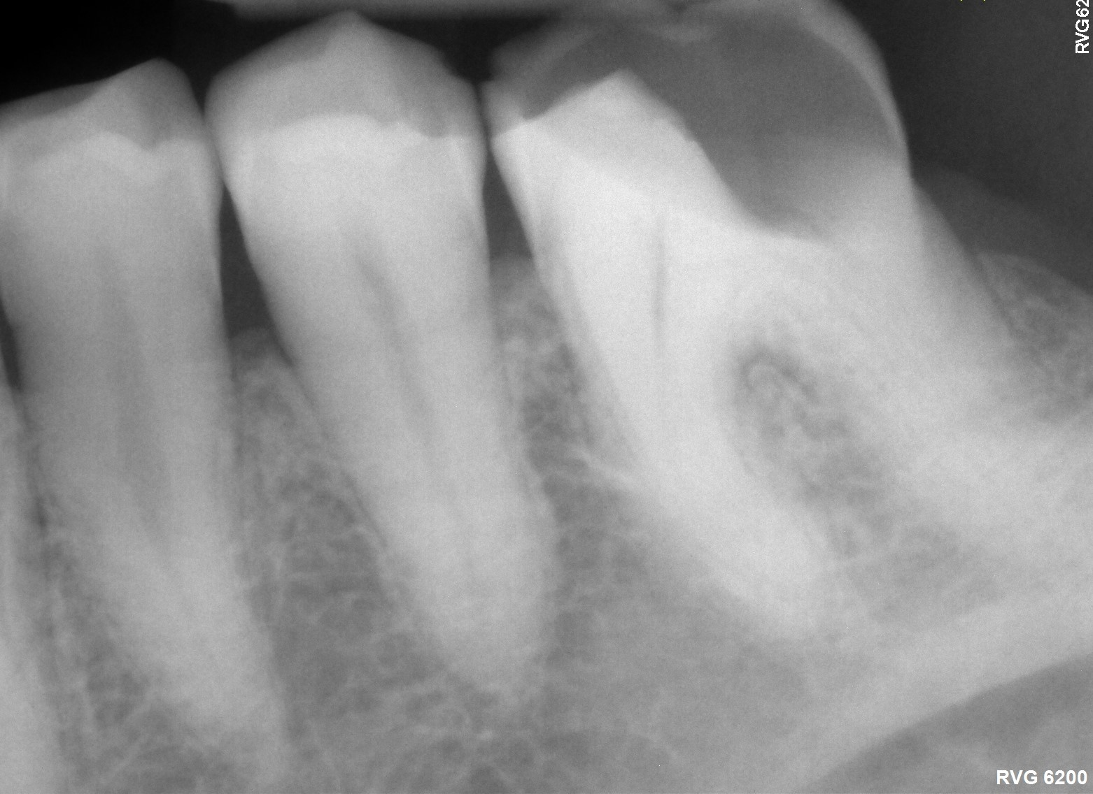
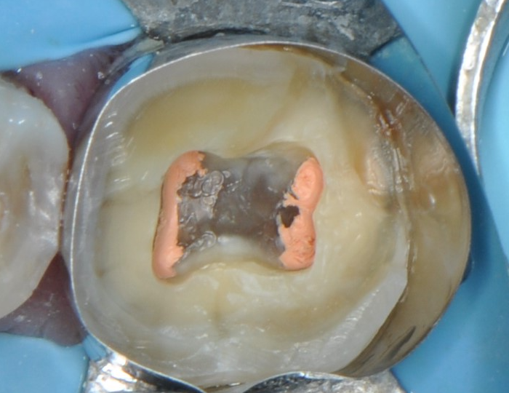
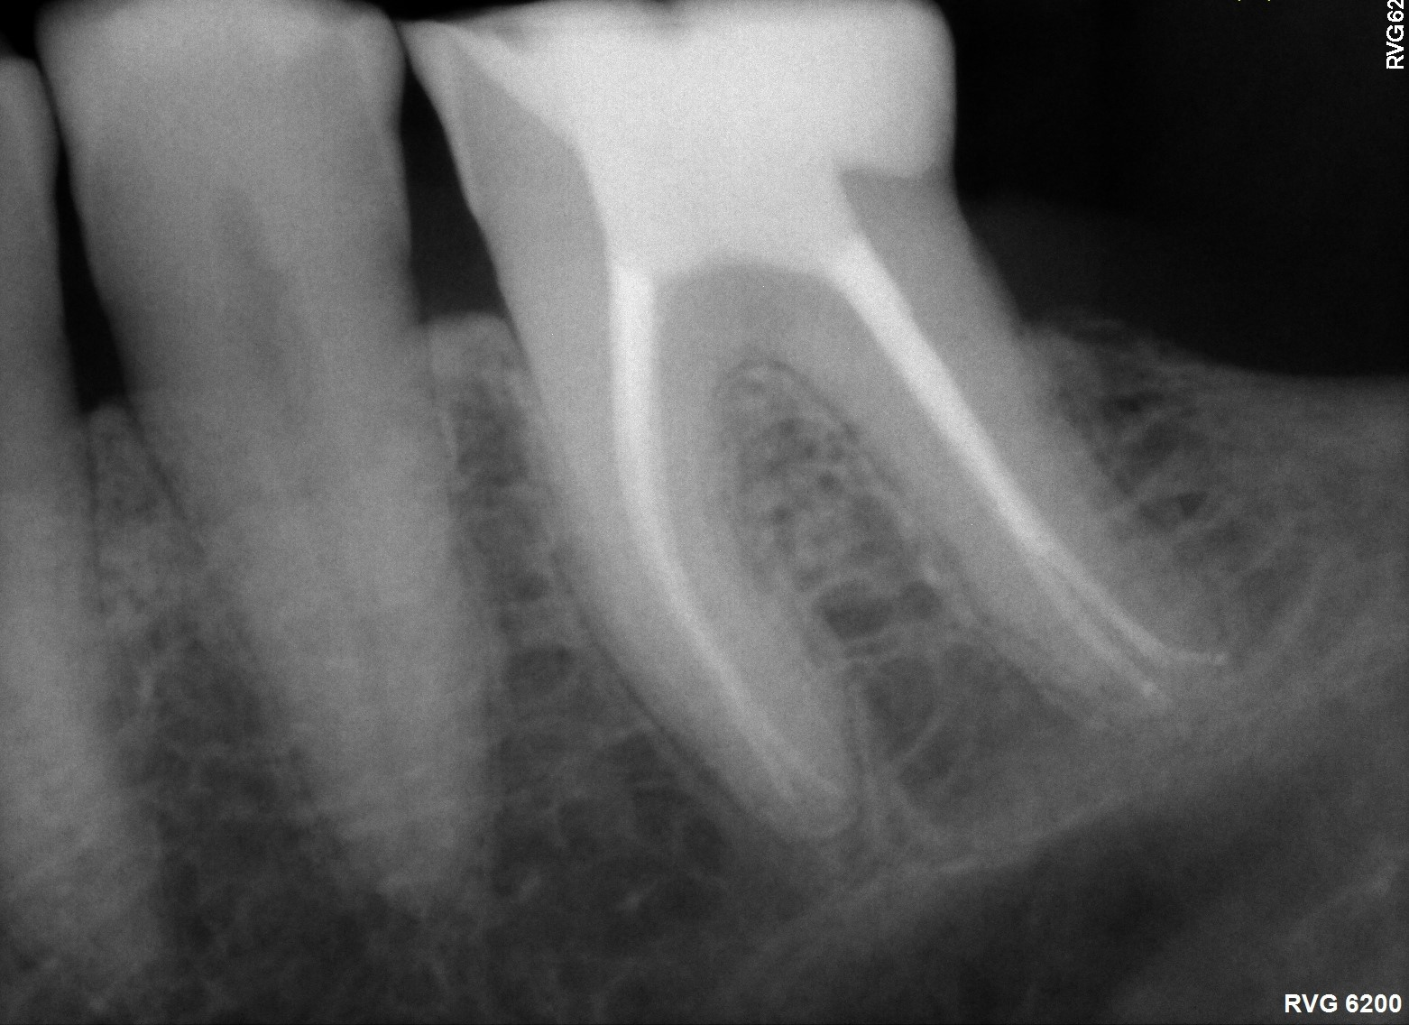
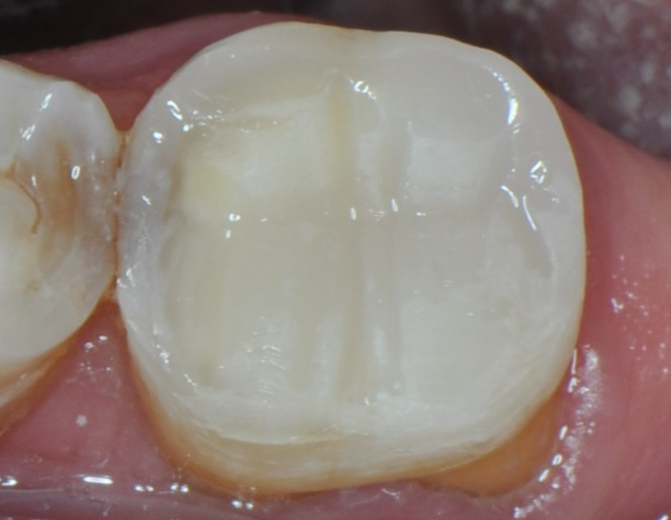
THE ACTIVA BioACTIVE PATIENT TREATMENT
Natural Remineralization* Support
Protection* against Secondary Caries
Large Class II Restoration/Direct Onlay
Before
After
Case courtesy Dr. Raymond Zhu.
Cases
Notes:
First molar occlusal caries

Slide 23
Technical profile & Ordering

Slide 24
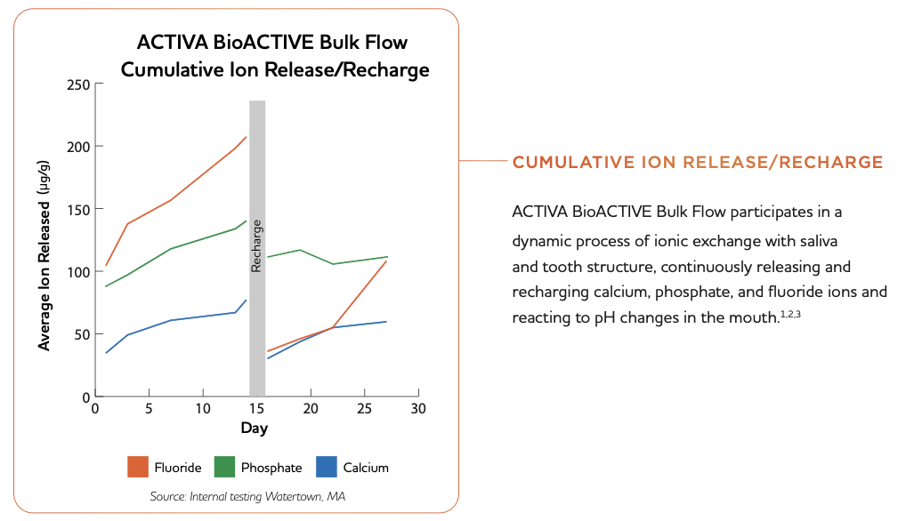
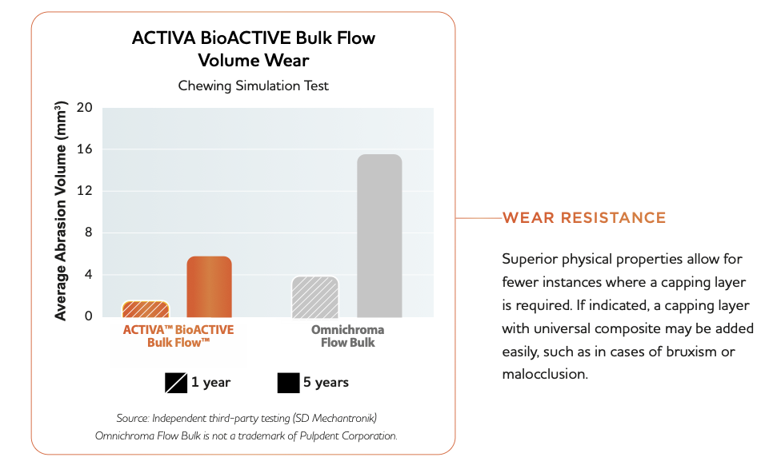
Natural Remineralization* Support
Protection* against Secondary Caries
Product Technical Profile

Slide 25
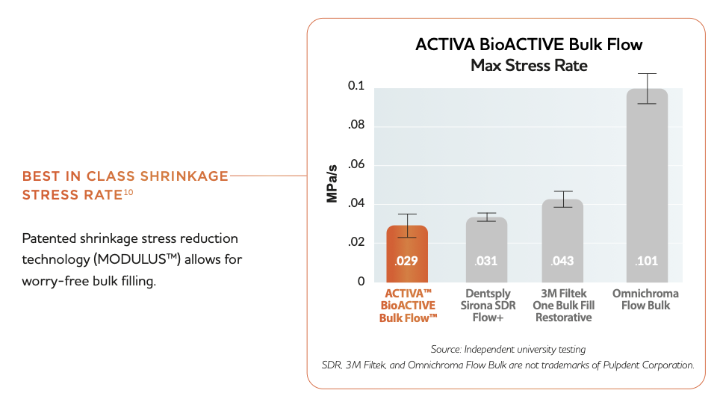
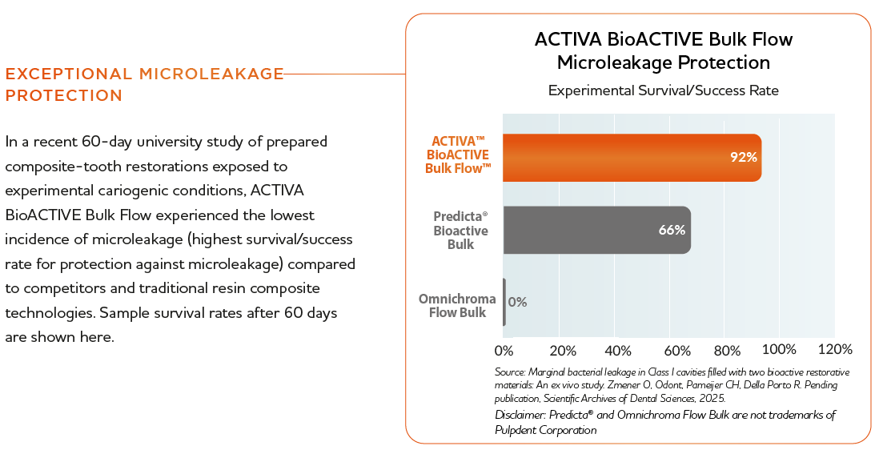
Natural Remineralization* Support
Protection* against Secondary Caries
Product Technical Profile

Slide 26
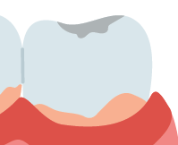
Natural Remineralization* Support
Protection* against Secondary Caries
THE ULTIMATE CLASS II (& I) SOLUTION FROM AWARD WINNING ACTIVA BIOACTIVE
Self-Leveling Restorative
Ultimate Adaptation
Indicated for All
Classes (I-V)
Bulk Fill
Efficiency & Ease
Universal Shade
Color Matching Simplicity
Remineralization Support & Protection
Self-Leveling 1-Step Placement, Unlimited Depth of Cure
Patented stress reduction technology, best in class low shrinkage stress rate
F⁻, Ca²⁺, PO₄³⁻exchange
mineral apatite formation & secondary caries protection
Biofilm modulation
ShadeFusion™ replaces most common Vita Shades
Simplify inventory
Product Summary
Notes:
*The remineralization process is a natural repair mechanism to restore the minerals again, in ionic forms, to the hydroxyapatite (HAP) crystal lattice. (Arifa, M. K., Ephraim, R., & Rajamani, T. (2019). Recent advances in dental hard tissue remineralization: a review of literature. International journal of clinical pediatric dentistry, 12(2), 139.)
*Apatite crystal formations, unique to bioactive treatment products like ACTIVA™ BioACTIVE Bulk Flow, physically seal the material-tooth interface, protecting against microleakage, the leading cause of secondary caries and recurrent decay.

Slide 27
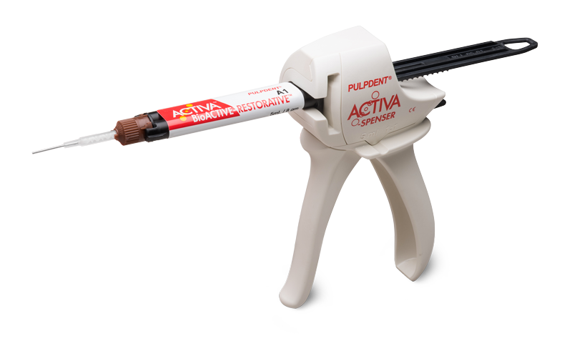
BULK FLOW & RESTORATIVE –COMPARED
KEY DIFFERENCES
BULK FLOW
RESTORATIVE
SHARED FEATURES
Viscosity
Great For
Other Potential Uses
Shade
Automix Tip
Low: Self-Leveling
Large Class I/II
Liner/Base
Endo Access Closure
ShadeFusion™
ShadeFusion™ KIDS
+ Kids Opaque White
19-gauge
High: Stacking
Restore & Repair –
Class V, Core Buildup, Class I/II, III
Deep Margin Elevation
A1 - A3.5
+ Kids Opaque White
20-gauge
Bulk Fill
Dual Cure
Core Chemistry
Bioactive Remineralization Support/Biofilm Modulation
Ionic Release/Recharge(Fl⁻, Ca²⁺, PO₄³⁻)
Restorative Comparison

Slide 28
Definitions, References & Citations
*The remineralization process is a natural repair mechanism to restore the minerals again, in ionic forms, to the hydroxyapatite (HAP) crystal lattice. (Arifa, M. K., Ephraim, R., & Rajamani, T. (2019). Recent advances in dental hard tissue remineralization: a review of literature. International journal of clinical pediatric dentistry, 12(2), 139.)
*Apatite crystal formations, unique to bioactive treatment products like ACTIVA™ BioACTIVE Bulk Flow, physically seal the material-tooth interface, protecting against microleakage, the leading cause of secondary caries and recurrent decay."

Slide 29

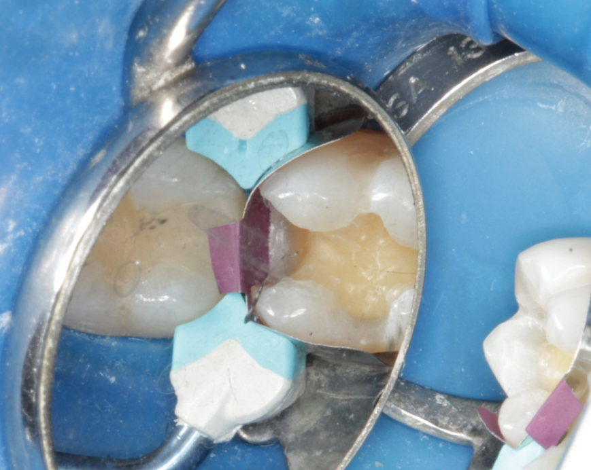
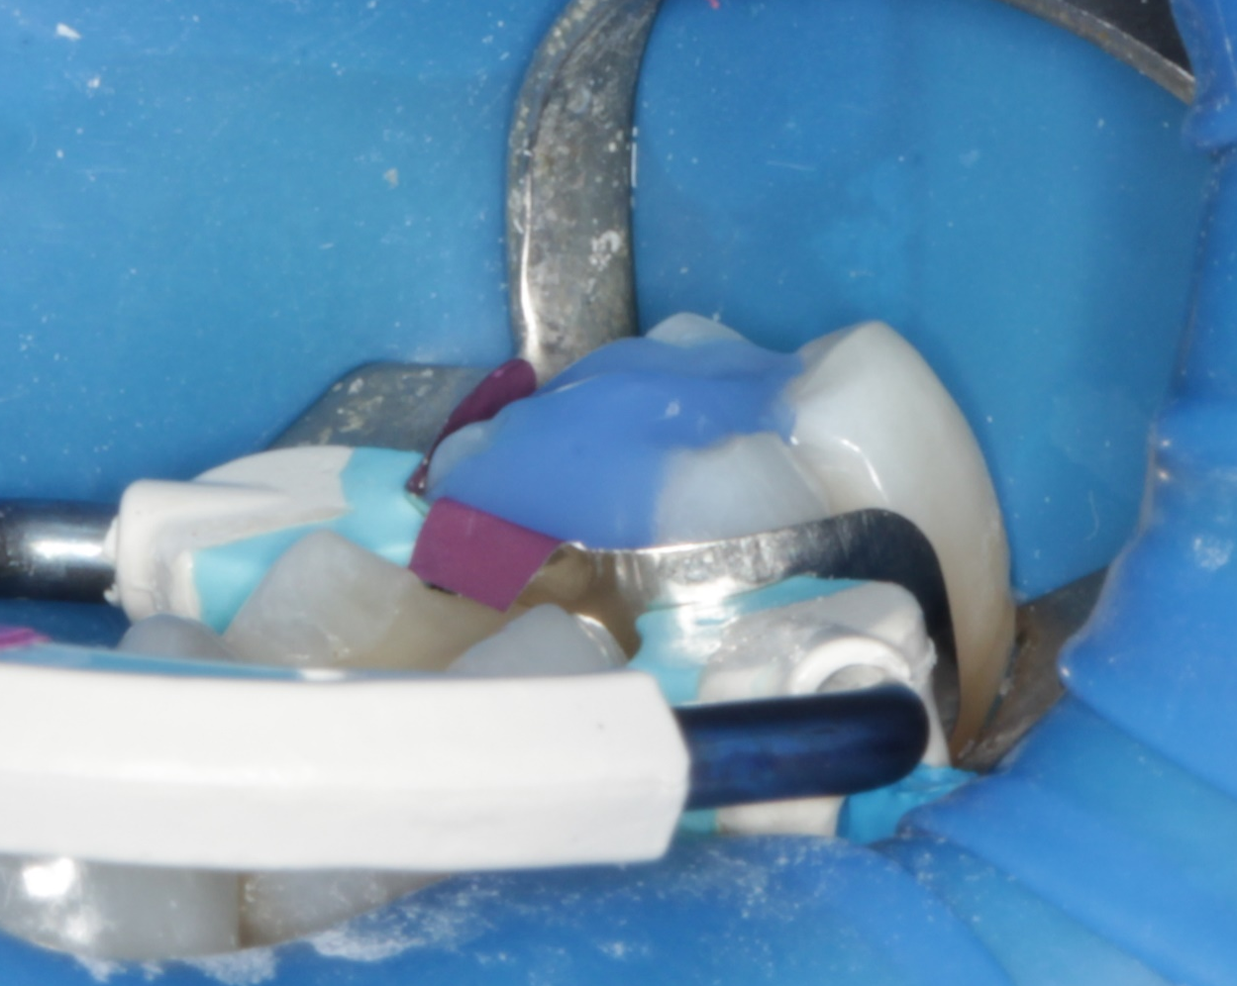
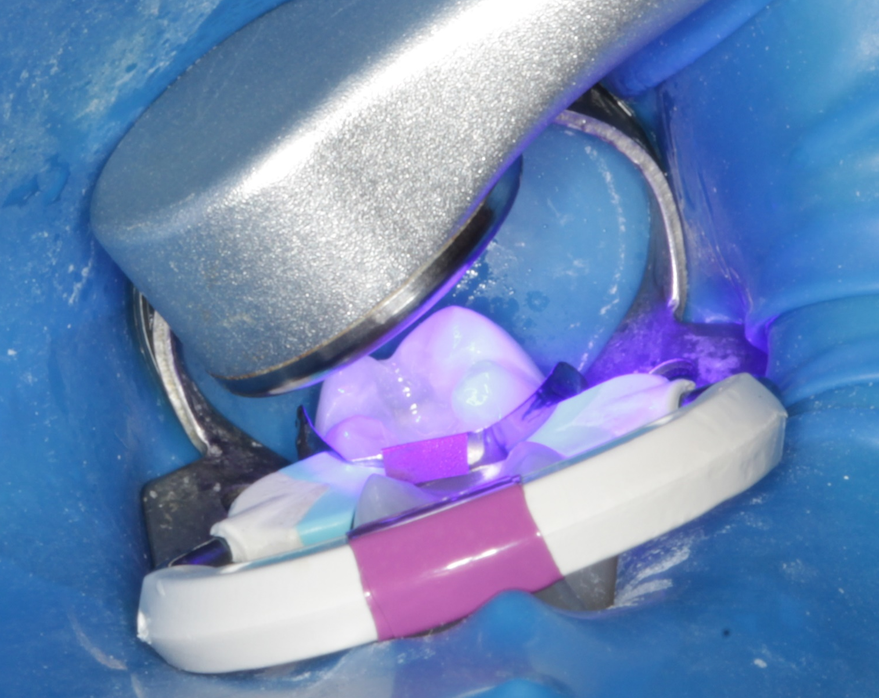
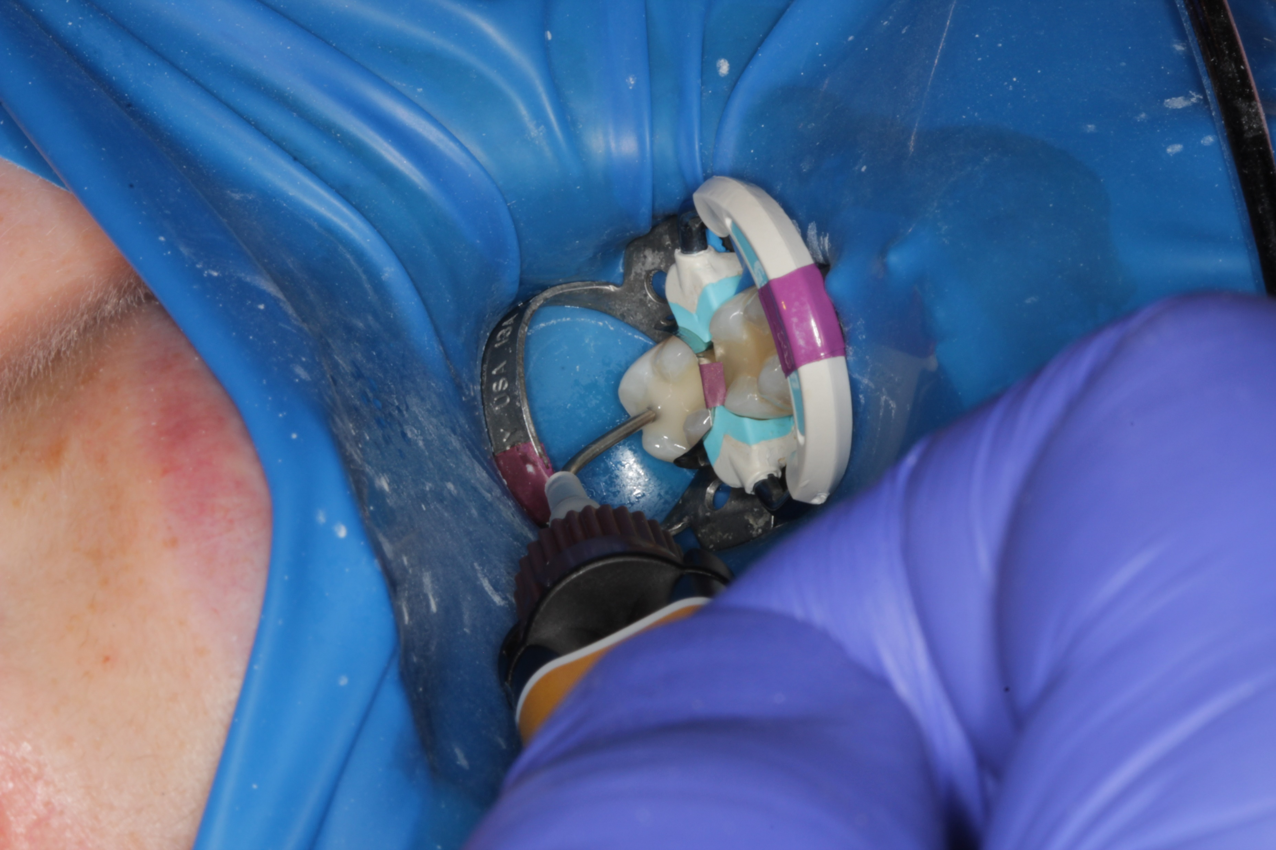

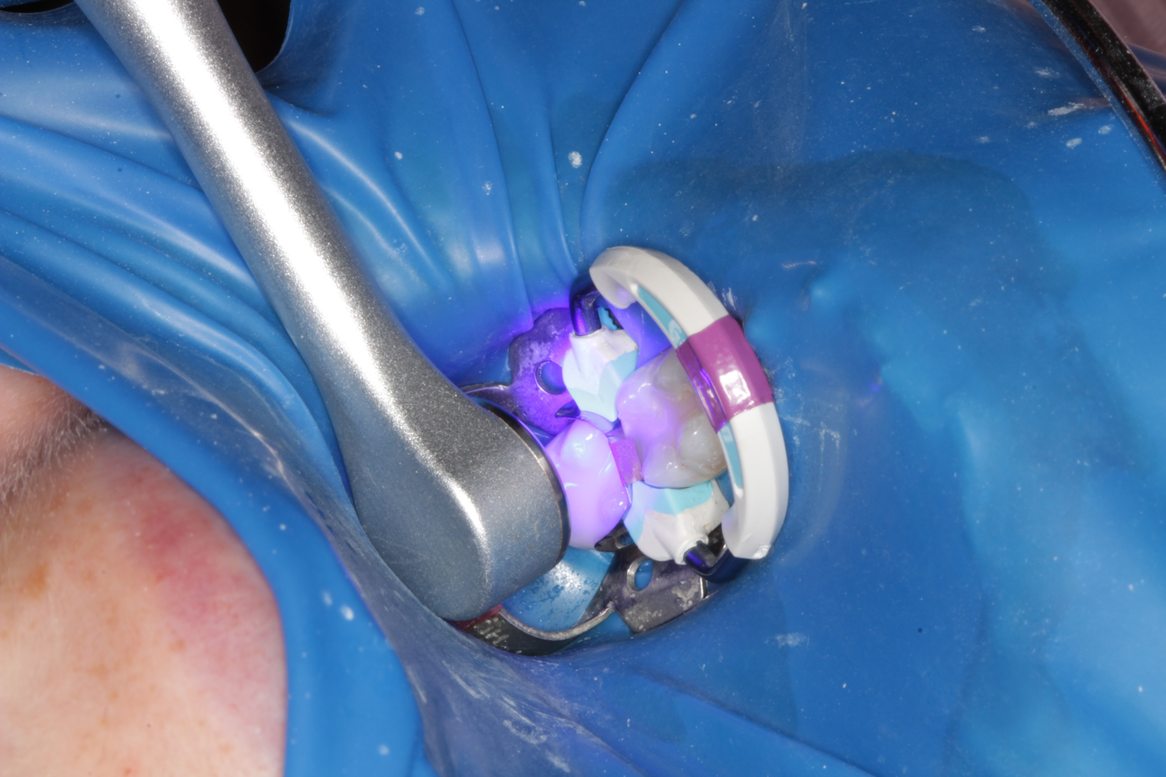
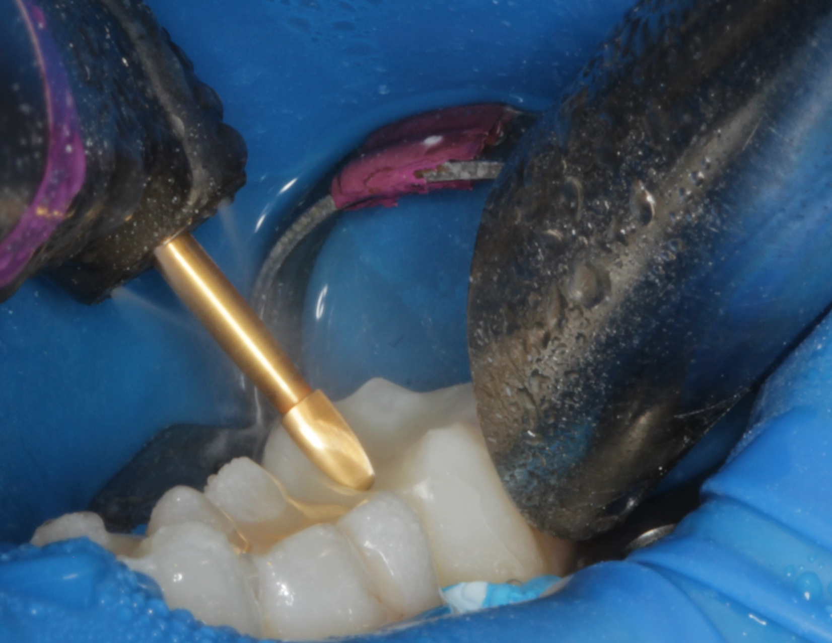


THE ACTIVA BioACTIVE PATIENT TREATMENT
Natural Remineralization* Support
Protection* against Secondary Caries
Large Class II Restoration
Case 1: Male patient presents with secondary decay underneath tooth #18 (tooth #19 remained viable). #18 is prepared for Class II (MO) restoration and etched with Etch-Rite™. A universal bonding agent is applied and cured, followed by one step bulk fill placement and final cure with ACTIVA BioACTIVE Bulk Flow. Case courtesy Dr. Les Rykiss
Note contrasting difference in aesthetics between restored #18 and remaining #19 after final contour and finishing.
Presentation
Class II prep
Etch
Bond + Cure
1-Step Placement
10 second cure
Contour
Finishing
Finishing
Immediate Post-op
Cases
Notes:
Tooth 5 occlusal caries

Slide 30

THE ACTIVA BioACTIVE PATIENT TREATMENT
Natural Remineralization* Support
Protection* against Secondary Caries
Large Class II Restoration/Direct Onlay
Case 2: ACTIVA Bulk Flow placed incrementally to restore a challenging, highly discolored, endodontically treated tooth that experienced previous failure with conventional composite restoration. Note excellent aesthetic outcome without the need for an opaquer or blocker. Case courtesy Dr. Raymond Zhu.
Pre-op/Prep
Completed Restoration
Cases
Notes:
Tooth 5 occlusal caries

Slide 31
Alternative Slides

Slide 32
ACTIVA’s BIOACTIVITY HELPS SOLVE CURRENT PROBLEMS
IN ADHESIVE DENTISTRY
THE PROBLEM SEEN DAILY
THE SOLUTION IS BIOACTIVE
Proprietary ION-X™ Polymer Technology
REMINERALIZATION
Support
BIOFILM
Modulation
Bioactive Problem Solving

Slide 33
ACTIVA’s BIOACTIVITY HELPS SOLVE CURRENT PROBLEMS
IN ADHESIVE DENTISTRY
THE PROBLEM SEEN DAILY
THE SOLUTION IS BIOACTIVE
REMINERALIZATION
Support
BIOFILM
Modulation
Bioactive Problem Solving

Slide 34
ACTIVA’s BIOACTIVITY HELPS SOLVE CURRENT PROBLEMS
IN ADHESIVE DENTISTRY
THE PROBLEM SEEN DAILY
THE SOLUTION IS BIOACTIVE
Proprietary ION-X™ Polymer Technology
REMINERALIZATION
Support
ACTIVA bonding interface
Reinforce margins
Harden demineralized tissue
BIOFILM
Modulation
Reduced plaque & biofilm adhesion
Bioactive Solutions

Slide 35



A NEXT-GEN RESTORATIVE -
BUILT ON CLINICAL SUCCESS & TECHNOLOGY OF ACTIVA BioACTIVE-RESTORATIVE

